Slide 1
Remaining Relevant in a Technologically Evolving World: The Goal of the Professional Accountants
Dr. Olumide Adedeji, FCA
May 20, 2024

Slide 2
In today’s world of advancement in technology and frequent innovations, the one consistent thing in our society is constant CHANGE. It is now the order of the hour (day). The fallout of this whole process is its unprecedented impact on the way we live, work and grow in our career. Before our eyes these days, entire profession and certain job titles are being wiped out as they are no longer relevant. Hence, you need to UPGRADE before life downgrade your career and become obsolete.

Slide 3
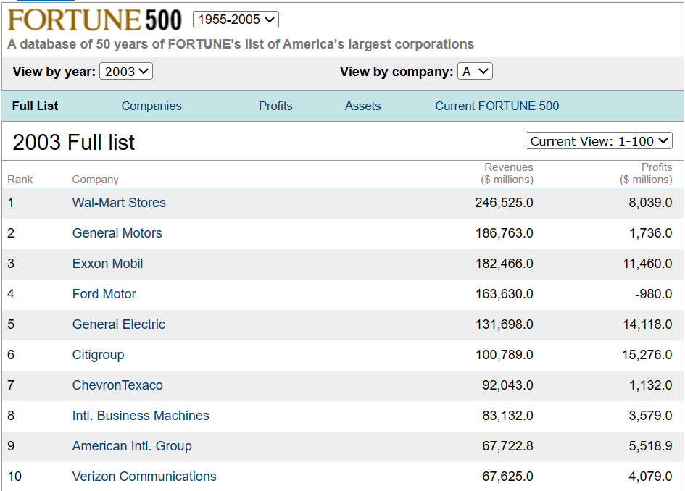
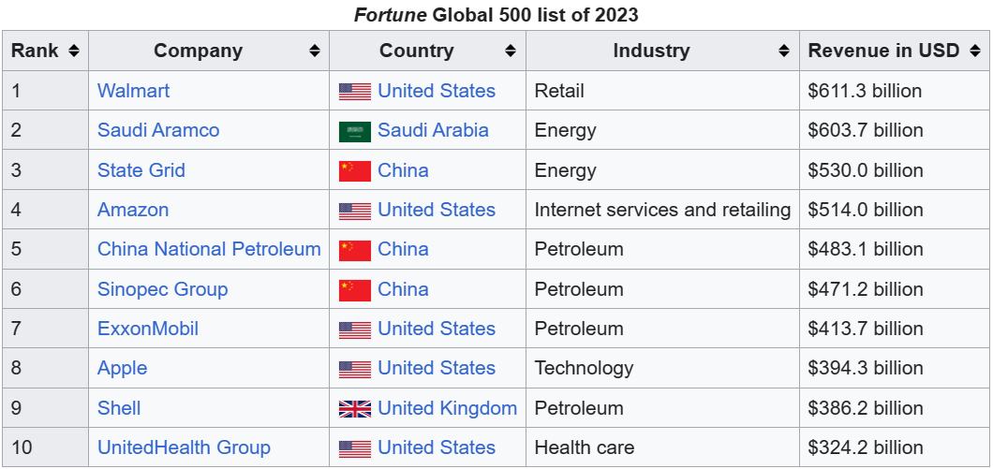

Slide 4
Walmart has one Theme: Swim or Sink A big lesson for the Professional Accountants because LIFE is not fair, you just need to UPGRADE to avoid Life’s DOWNGRADE.

Slide 5
Hence, you are required to remain relevant in a Technologically Evolving World, as if you have a choice.

Slide 6
Table of Content
What’s next?
01
Background
04
The requirements
Reality Check
02
03

Slide 7
Background

Slide 8
Smartphones Tablet watches Accessories Samsung reporting revenue of $54.9 billion for the quarter ending March 2024. Samsung entered the smartphone market with its first smartphone model in June 2009.
iPhone
MacBook
iPad
Accessories
Apple reporting revenue of $90.8 billion for the quarter ending March 2024.
The first Apple smartphone, known as the iPhone, was launched on June 2007.

Slide 9
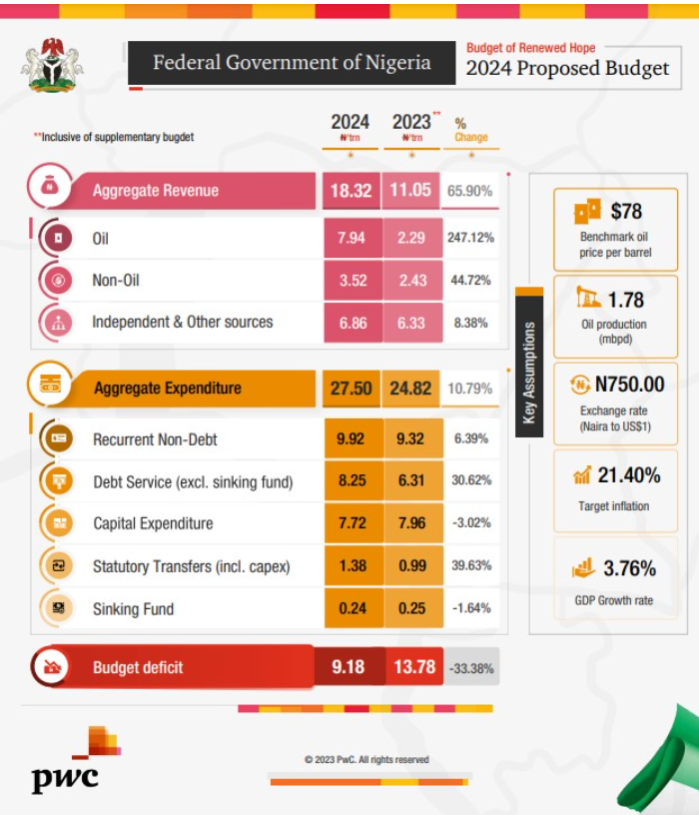
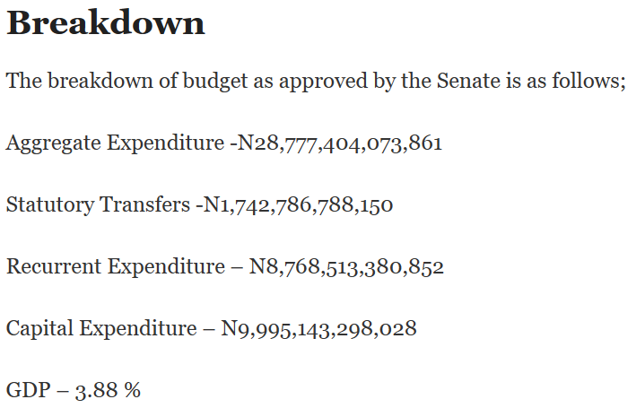
Smartphones Tablet watches Accessories Samsung reporting revenue of $54.9 billion for the quarter ending March 2024. Samsung entered the smartphone market with its first smartphone model in June 2009.
iPhone
MacBook
iPad
Accessories
Apple reporting revenue of $90.8 billion for the quarter ending March 2024.
The first Apple smartphone, known as the iPhone, was launched on June 2007.

Slide 10
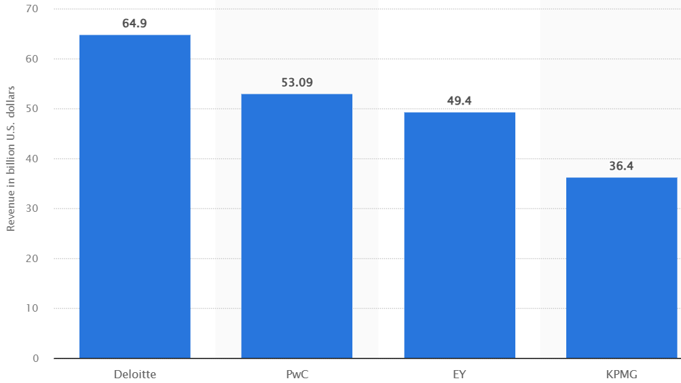

Slide 11
Deloitte: Deloitte was founded in 1845 by William Welch Deloitte in London, United Kingdom. PricewaterhouseCoopers (PwC): PwC traces its roots back to the founding firm of Price Waterhouse which was established in 1849 by Samuel Lowell Price in London, United Kingdom. Ernst & Young (EY): had its origins in the founding of Ernst & Ernst in Cleveland, Ohio, in 1903, while Arthur Young & Co. since 1906. KPMG: KPMG's history dates back to the founding of several accounting firms, Klynveld Peat Marwick Goerdeler since 1870 These firms have since grown into multinational professional services organizations, offering a wide range of services beyond traditional accounting, such as consulting, advisory, and tax services.

Slide 12
Imagine a Professional Accountant with a combined synergy
Of the Big 4 Professional Skill-Set and Apple/Samsung’s Power of Technology???

Slide 13
Remaining Relevant in a Technologically Evolving World: The Goal of the Professional Accountants

Slide 14
Reality Check

Slide 15
Technology will not replace Accountants but Techy-savvy accountant will replace non-tech savvy accountant.
According to Statistics, jobs for accountants and auditors are projected to grow by 4% between 2019 and 2029, which is on par with the projected average for all occupations.
Despite many accounting tasks being automated, accounting professionals will never be replaced by technology as a publication notes, “technology simply cannot — and will never be able to — solve on its own”.
In fact, accountants in the future will have the opportunity to develop more advanced skills so that they can increasingly serve as business consultants and strategic partners as opposed to simply financial experts.

Slide 16
Technology such as data analytics, artificial intelligence and robotic process automation will be playing a greater role in the accounting profession within the next five years
Some routine accounting tasks may be automated as platforms such as cloud computing, artificial intelligence (AI), and blockchain become more widespread. Although it will increase accountants' efficiency, this change is not expected to reduce overall demand. The automation of routine tasks, such as data entry, will instead make accountants' advisory and analytical duties more prominent.
The four main trends our research has identified are the growth of blockchain, advancement of automation, spread of agile accounting and rise of more widespread third-party involvement.

Slide 17
Remaining relevant in a technologically evolving world is essential for professional accountants to thrive in their careers.
Here's a catalogue of requirements for professional accountants to stay ahead in this dynamic landscape:

Slide 18
Requirements

Slide 19
Join a professional
organization/association
Joining a professional organization/association can be a great way to stay on top of emerging technology that directly affects your industry. Many professional organizations produce Subject Matter Experts filled with current news and tech advances.
Every ICAN District has at least 10% of its members who are technologically upwardly mobile – pair up with them.

Slide 20
Find a mentor
You can find a mentor that is tech-savvy and learn from them. Read the technology publications they read and follow the tech sites they recommend. Meet periodically with your mentor to discuss tech advances and applications in the workplace.

Slide 21
Attend industry conferences and tech events
Conferences are a great opportunity to see innovative technology specific to your industry. You can listen to industry leaders, attend classes and talk with vendors about their products. You can also check out technology-focused events and apply what you have learned to your industry. Many conferences make their keynote speeches available online for those that don't have the time or budget to attend in person.

Slide 22
Devote time daily to tech news
To be very happy in life, devote a small portion of each day to stay up to date with technology news. For the most balanced approach, you can get your news from technology-focused publications and tech news sites online. Find a few reputable sites you are comfortable with and stick with them. To save time, you can set up site keywords to receive key news items daily.

Slide 23
Connect with social media
There are many influencers devoted to technology and emerging trends. You can subscribe to newsletters or set alerts to notify you when your favorite tech influencer posts new material. Besides influencers, you can follow industry and tech company accounts to learn about emerging technologies on their social media handles.

Slide 24
Prioritize learning
Making learning a priority is a big part of keeping up with technology.
Some online classes offer tech and industry-specific certifications. You can also take online classes through colleges or universities. Not only do college classes offer the chance to collaborate with others in your field, but they also allow you to experience current technologies used by businesses with virtual employees.

Slide 25
Share ideas with your peers – A tree doesn’t make a forest.
Set up periodic meetings with co-workers, professionals from other departments and industry colleagues to talk about technology on the job. These meetings are a great way to learn about emerging tech, how others are using it and expected changes in your industry.

Slide 26
Watch TED talks
TED talks are a simple way to stay current with technology in your free time. Many TED talks are by professionals you would see at a conference. Most talks are only 10 to 20 minutes long, are free to watch and cover a range of topics. You can save some search time by curating your TED feed to focus on technology, innovation and professional growth.

Slide 27
Listen to podcasts
If you are an auditory learner, podcasts can be a great way to keep up to date on general technology news and industry-specific technological advances. There are even podcasts that serve as virtual coding classes. Podcasts are free and you can listen to them anywhere.

Slide 28
Be willing to experiment
Practice and experimentation is a key part of staying up to date with technology. A passion project keeps your technical skills sharp while experimenting with a new coding language or platform.
Many sites offer tutorials and space to work on projects. Even you can benefit from the many online tutorials that provide the opportunity to practice and play with new tech, most without a significant investment of cash.

Slide 29
What’s Next?

Slide 30
ICAN’s Vision Statement states:
“To be a leading Global professional body.”
What about you? What’s your vision statement?
Will you still be relevant in the next 5 years?

Slide 31
References
ICAN induction 2023 extract
KPMG report (2023) extract
PWC report (2023) extract
EY report (2023) extract
Deloitte report (2023) extract
Fortune 500 (2003) extract
Fortune 500 (2023) extract
Samsung AFS Q1 2024
Apple AFS Q1 2024

Slide 32
Thank you and God Bless.
92

