Slide 2
Fintech Industry
Fintech, or financial technology, refers to any software that provides financial services, including internet banking, mobile payment apps.
$731 billion
Worth of Digital payment transactions completed in 2023
(Monthly average of $60.9 billion)
Export
Real Estate
Health
Tourism
Payment Solutions power all Sectors
Transport
Banking
FMCG
Logistics
© 2024 Flutterwave Inc. Confidential and proprietary

Slide 3
Fintech Benefits
Financial Inclusion: 99 million Adults are excluded from the Financial services. Through internet penetration and targeted services, a broader spectrum can be reached
Tailored Services: Adaptive services enable fintech to meet customer needs
Transparency : Fintechs enable users interact with products which solve their needs
Cost saving on fees : With more tailored solutions, users pay for only what they need
Convenient Payment
Data Protection
Reliability
Global Coverage
User experience
Innovative technology
© 2024 Flutterwave Inc. Confidential and proprietary

Slide 4
Emerging Technologies
Cyber Security
Blockchain: Applications, benefits, and challenges
Artificial Intelligence (AI): Machine learning, natural language processing, and computer vision
Internet of Things (IoT): Connected devices, smart cities, and industrial automation
Other emerging technologies (e.g., 5G, quantum computing, augmented reality)
Threat landscape: Types of attacks, vulnerabilities, and risk management
Security measures: Encryption, firewalls, access control, and incident response
Data protection: GDPR, HIPAA, and data privacy regulations
Cybersecurity best practices: Password management, network security, and employee training
Venture Capital and Funding Sources
Industry Applications
Venture capital overview: Types, stages, and investment strategies
Funding options: Equity, debt, grants, and crowdfunding
Pitching to investors: Best practices and common mistakes
Building a strong startup ecosystem: Incubators, accelerators, and coworking spaces
Fintech: Blockchain-based payment systems and digital wallets
Healthcare: AI-powered diagnosis and telemedicine platforms
Smart cities: IoT-enabled infrastructure and transportation systems
Success stories: Startup case studies and entrepreneur interviews

Slide 5
Future Outlook and Trends
Emerging tech trends: Edge computing, serverless architecture, and autonomous vehicles
Industry predictions: Expert insights and market forecasts
Innovation hubs: Global hotspots for tech entrepreneurship
Talent development: Skills required for the future tech workforce

Slide 6
© 2023 Flutterwave Inc. Confidential and proprietary

Slide 7
About Flutterwave – Overview
Flutterwave makes sending & receiving payments frictionless for businesses and consumers
400+
Banks, Card Schemes & Mobile Wallets
200m+
Processed Transactions (Volume)
$16B+
Processed Transactions (Value)
35+
Countries with local presence
1 million
+
Enterprise / Small Business Merchants
Pan African Focus with strong presence in Major Markets

Slide 8
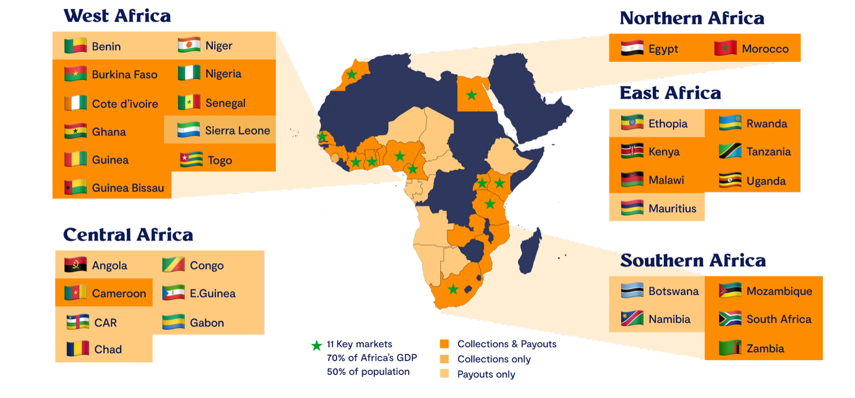
About Flutterwave – Geographical Coverage
Flutterwave is present in 35+ countries in Africa, North America, Europe, Asia & Middle East

Slide 9
Enterprise-Level Security & Compliance
Military Grade-Data Encryption
PCIDSS Certification
Multi-Factor
KYC & Audit Trail
Maintenance & Service time
We take security very seriously. We have Africa’s top security experts on our product team making sure that from conception to deployment security is key.
We have our PCIDSS certification Level 1 from Trustwave and we are a Qualified Security Assessor.
We provide multi-level factor security. All payments must be confirmed by sender via OTP.
Our digital audit trail makes investigating fraud, source of funds and identities of recipients easy.
All customers are plugged into our automated AML/Fraud monitoring tools
Our Engineering team continuously performs Quality assurance and system upgrades
Our infrastructure is designed to provide an uptime of 99.9% this is achieved through load balancing techniques, comprehensive redundancy policies
© 2023 Flutterwave Inc. Confidential and proprietary

Slide 10
Our Product:
The Flutterwave Business Platform
© 2023 Flutterwave Inc. Confidential and proprietary

Slide 11
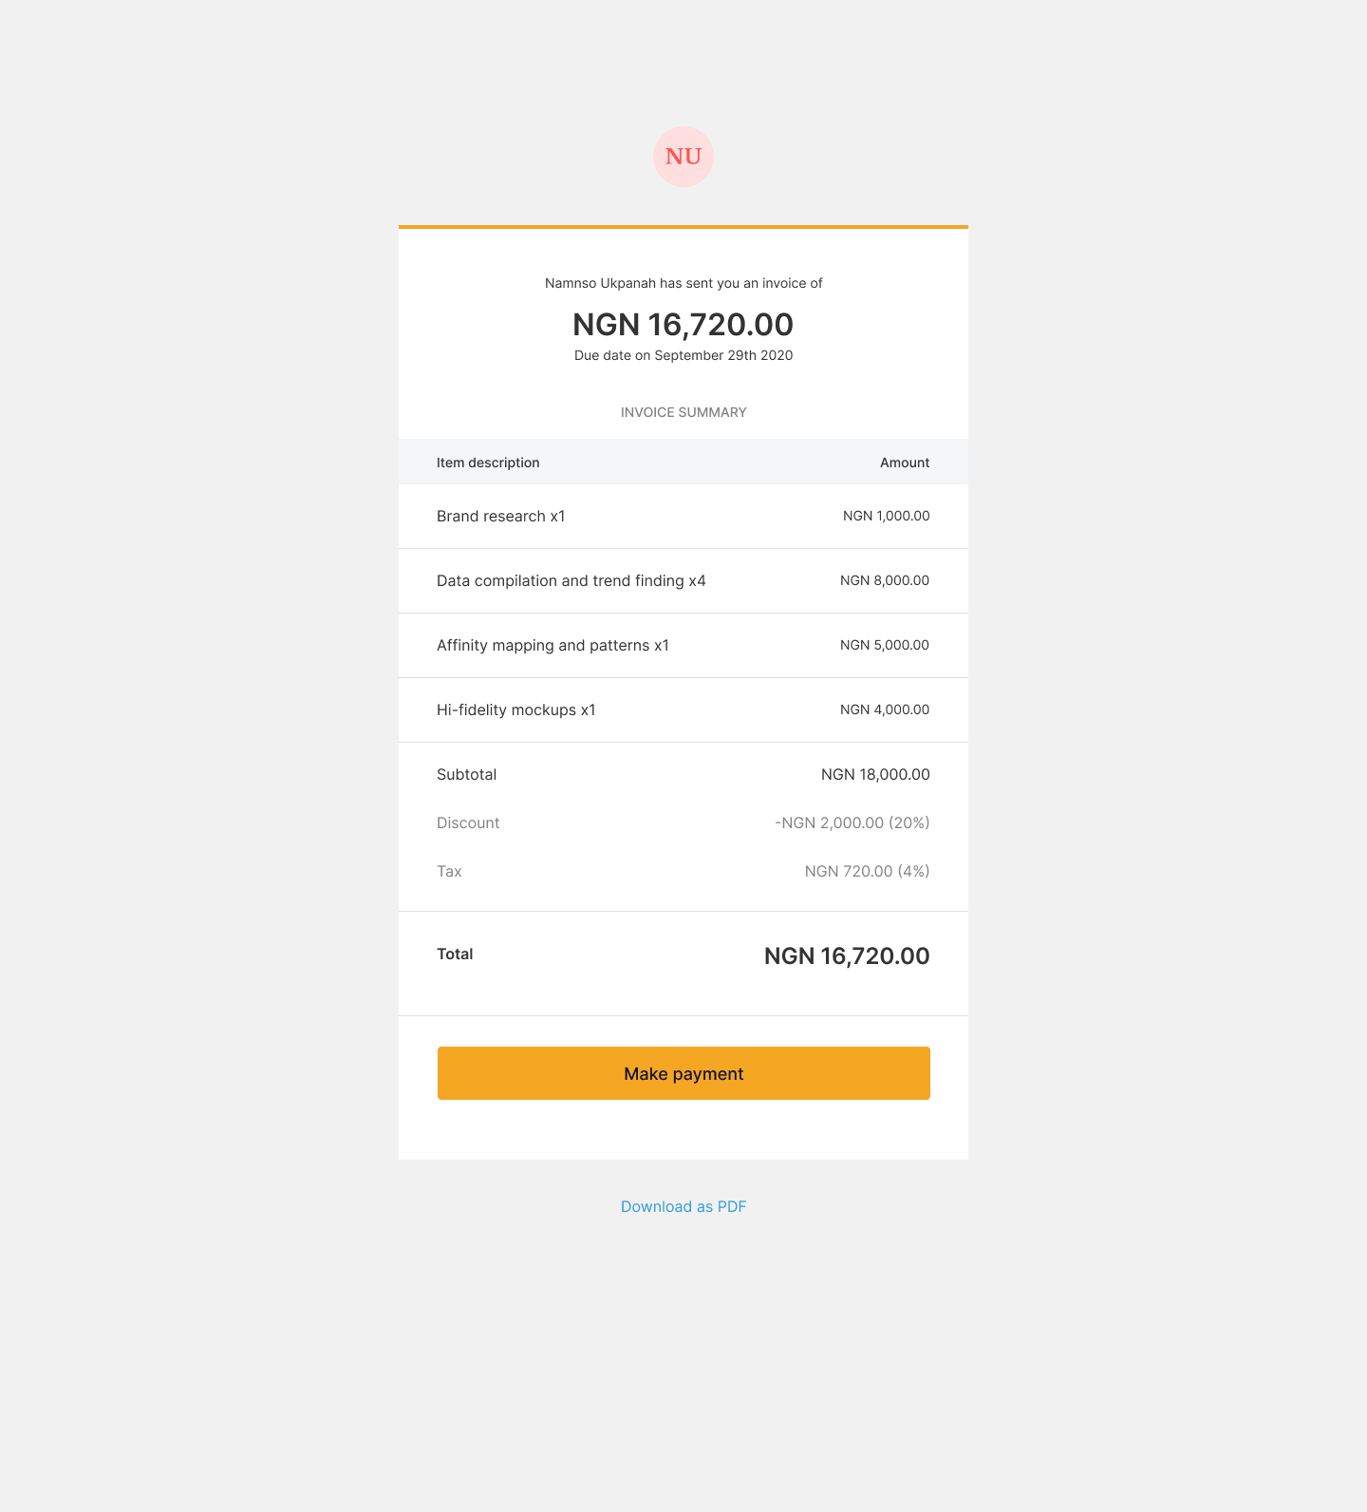
Invoices
Create and send invoices on the go with Flutterwave Invoicing.
Create professional invoices easily for ship invoices, goods invoices, sea port access etc
Send invoices in multiple currencies and accept payments from customers in over 150 currencies and via multiple payment methods
Track payments and overdue invoices
Remind your customers to pay on time with automated reminders
Easy sales & tax calculations.
© 2022 Flutterwave Inc. Confidential and proprietary

Slide 12
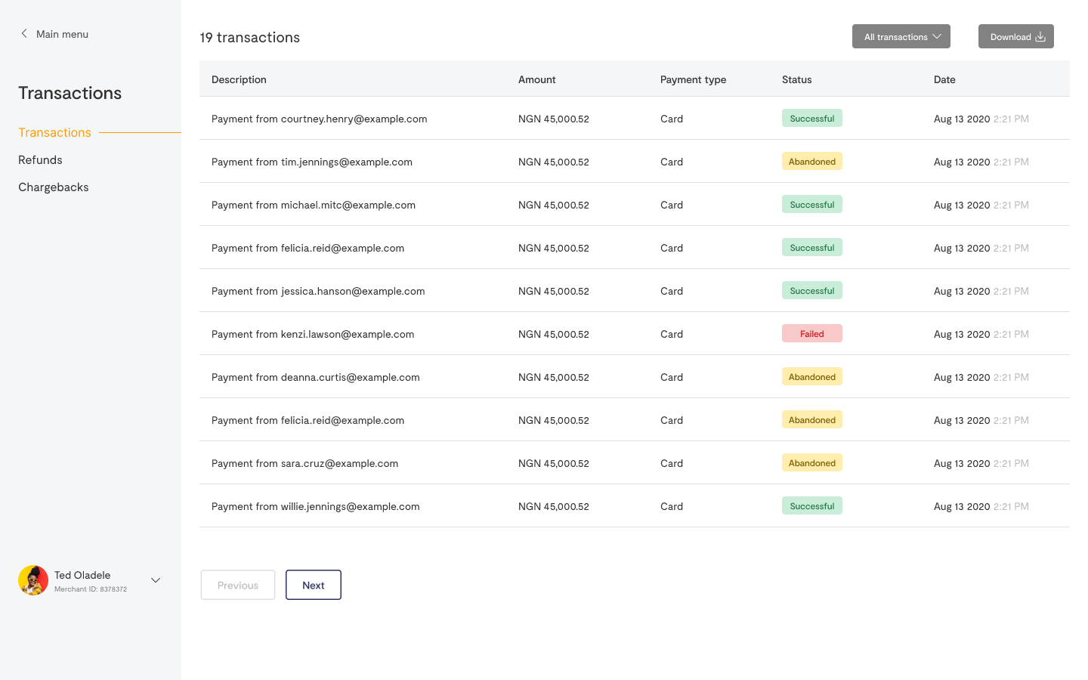
White-Label Solution
With our white-label payment gateway solution, OFI and organisations are able to offer their ecosystem the best payment experience.
Through the support of our Integration specialists, you will be up and running in a short while and plugged in to enable your clients and partners collect payments from their customers via their preferred payment methods.
You will also be able to customize the payment gateway in line with your brand, perform administrative duties,create accounts for clients, monitor settlements and make revenue from offering your merchants the payment service.
Customisations available for:
configurations
functionalities
merchant services
pricing models
© 2023 Flutterwave Inc. Confidential and proprietary

Slide 13
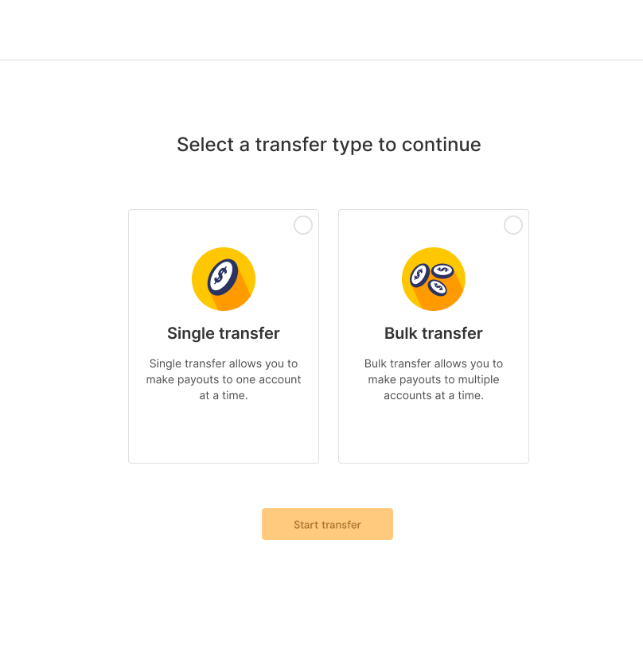
Single or Bulk Payments
Send single and bulk payment in multiple currencies for salary payment, vendor payment or power your disbursements with our robust disbursement API.
© 2023 Flutterwave Inc. Confidential and proprietary

Slide 14
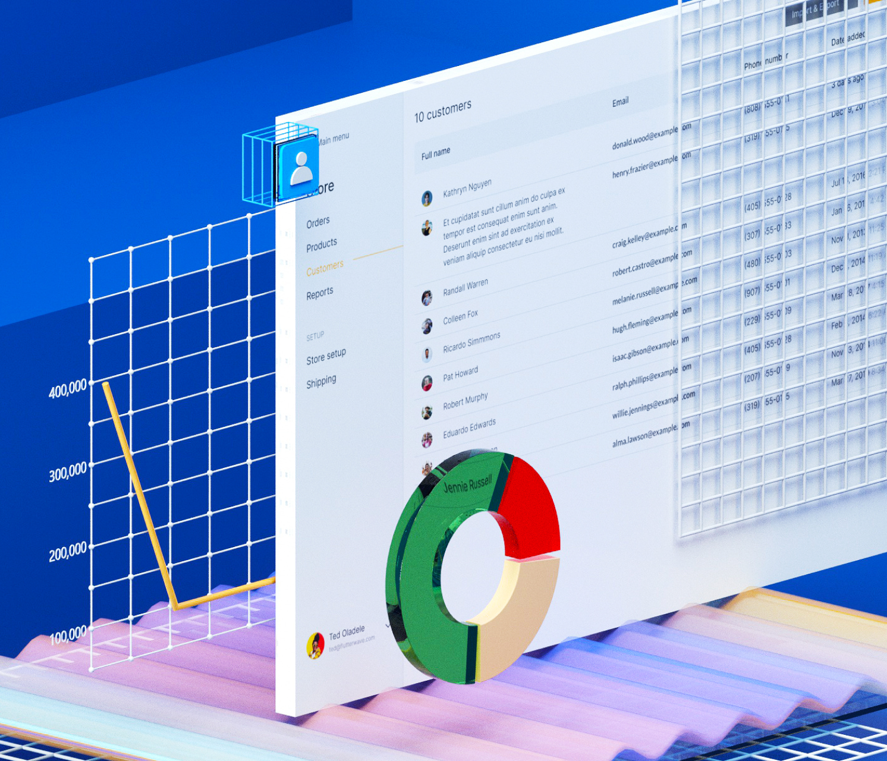
Dashboard
Our dashboard gives you the power to take control of your business by providing you with insights, profile authorisations and the ability to set your payment preferences
Transaction review and settlements reconciliation is all controlled from the primary merchant account on the dashboard.
Each transactions detail can be viewed providing payer account, total amount, type of payer etc
© 2022 Flutterwave Inc. Confidential and proprietary
Notes:
Add a slide about the dashboard and a statement about the dashboard

Slide 15
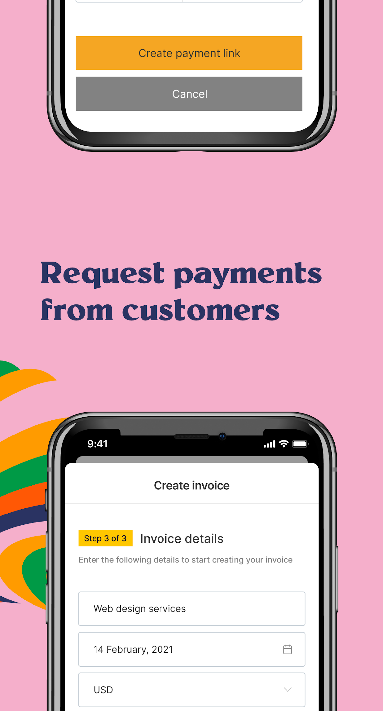
Payment methods
Cards (including local scheme – Verve)
Mobile Money
Pay With Bank Account
Pay With Bank Transfer
USSD
NIBSS QR Codes
Paypal
Mobile Wallet (Barter, Payattitude, Paga)
*Payment channels include Mobile money, Orange money
© 2023 Flutterwave Inc. Confidential and proprietary

Slide 16
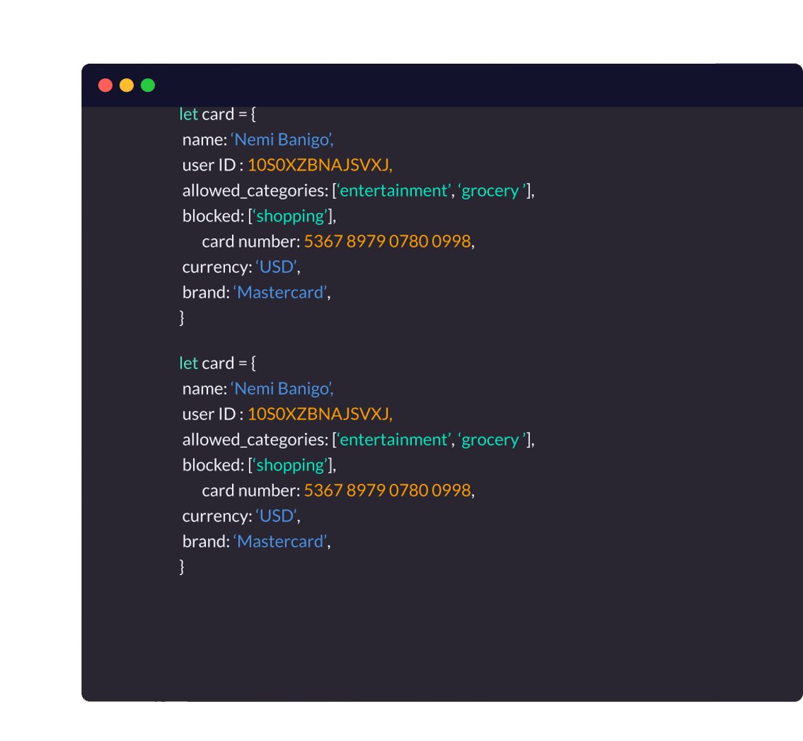
Leverage our APIs
Leverage our robust easy-to-use REST APIs. We offer simplicity and ease of use APIs to power your business across multiple African countries. We offer:
Whatsapp Business Messaging services
KYC verification
Customized USSD set-up and menu management
Card Bin verification services
Access to multiple billers - Telecoms, Utilities, Govt. Agencies, ISPs, Airlines, Schools, Religious bodies, Charities etc.
Ours is a one-stop shop for easy payments.
© 2023 Flutterwave Inc. Confidential and proprietary

Slide 17
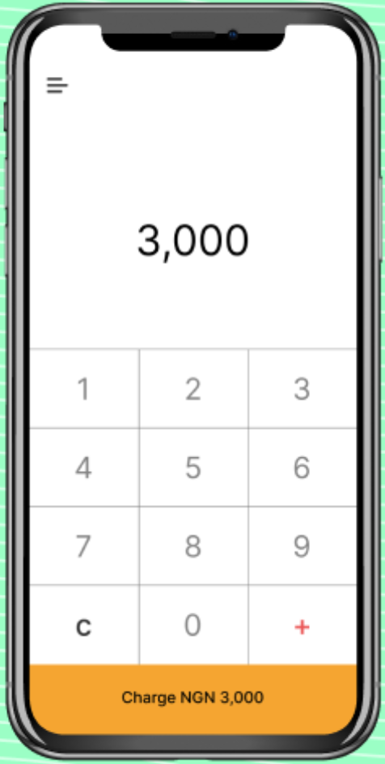
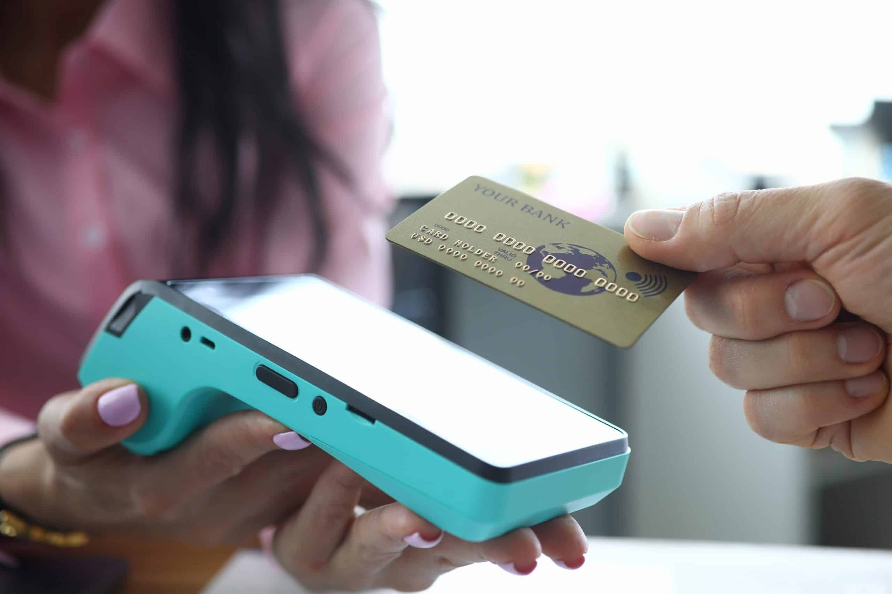
Accept Payments via POS Devices
Accept payment using our soft POS solution or our POS devices across retail chains/stores.
Enjoy seamless and automated reconciliation via our real time payment dashboard.
© 2023 Flutterwave Inc. Confidential and proprietary

Slide 18
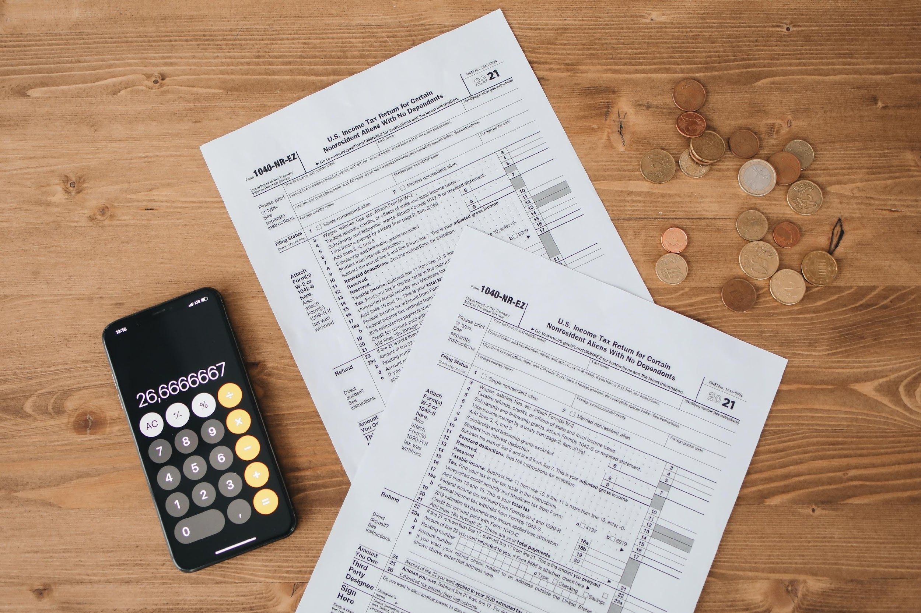
Use Case: Government Collections, Payout & Taxes
From Tax payments to fees & deductions, to immigration and driving license payments, Flutterwave makes it easy for Governments to collect payment from citizens both home & abroad without any technology dependencies
© 2022 Flutterwave Inc. Confidential and proprietary

