Slide 1
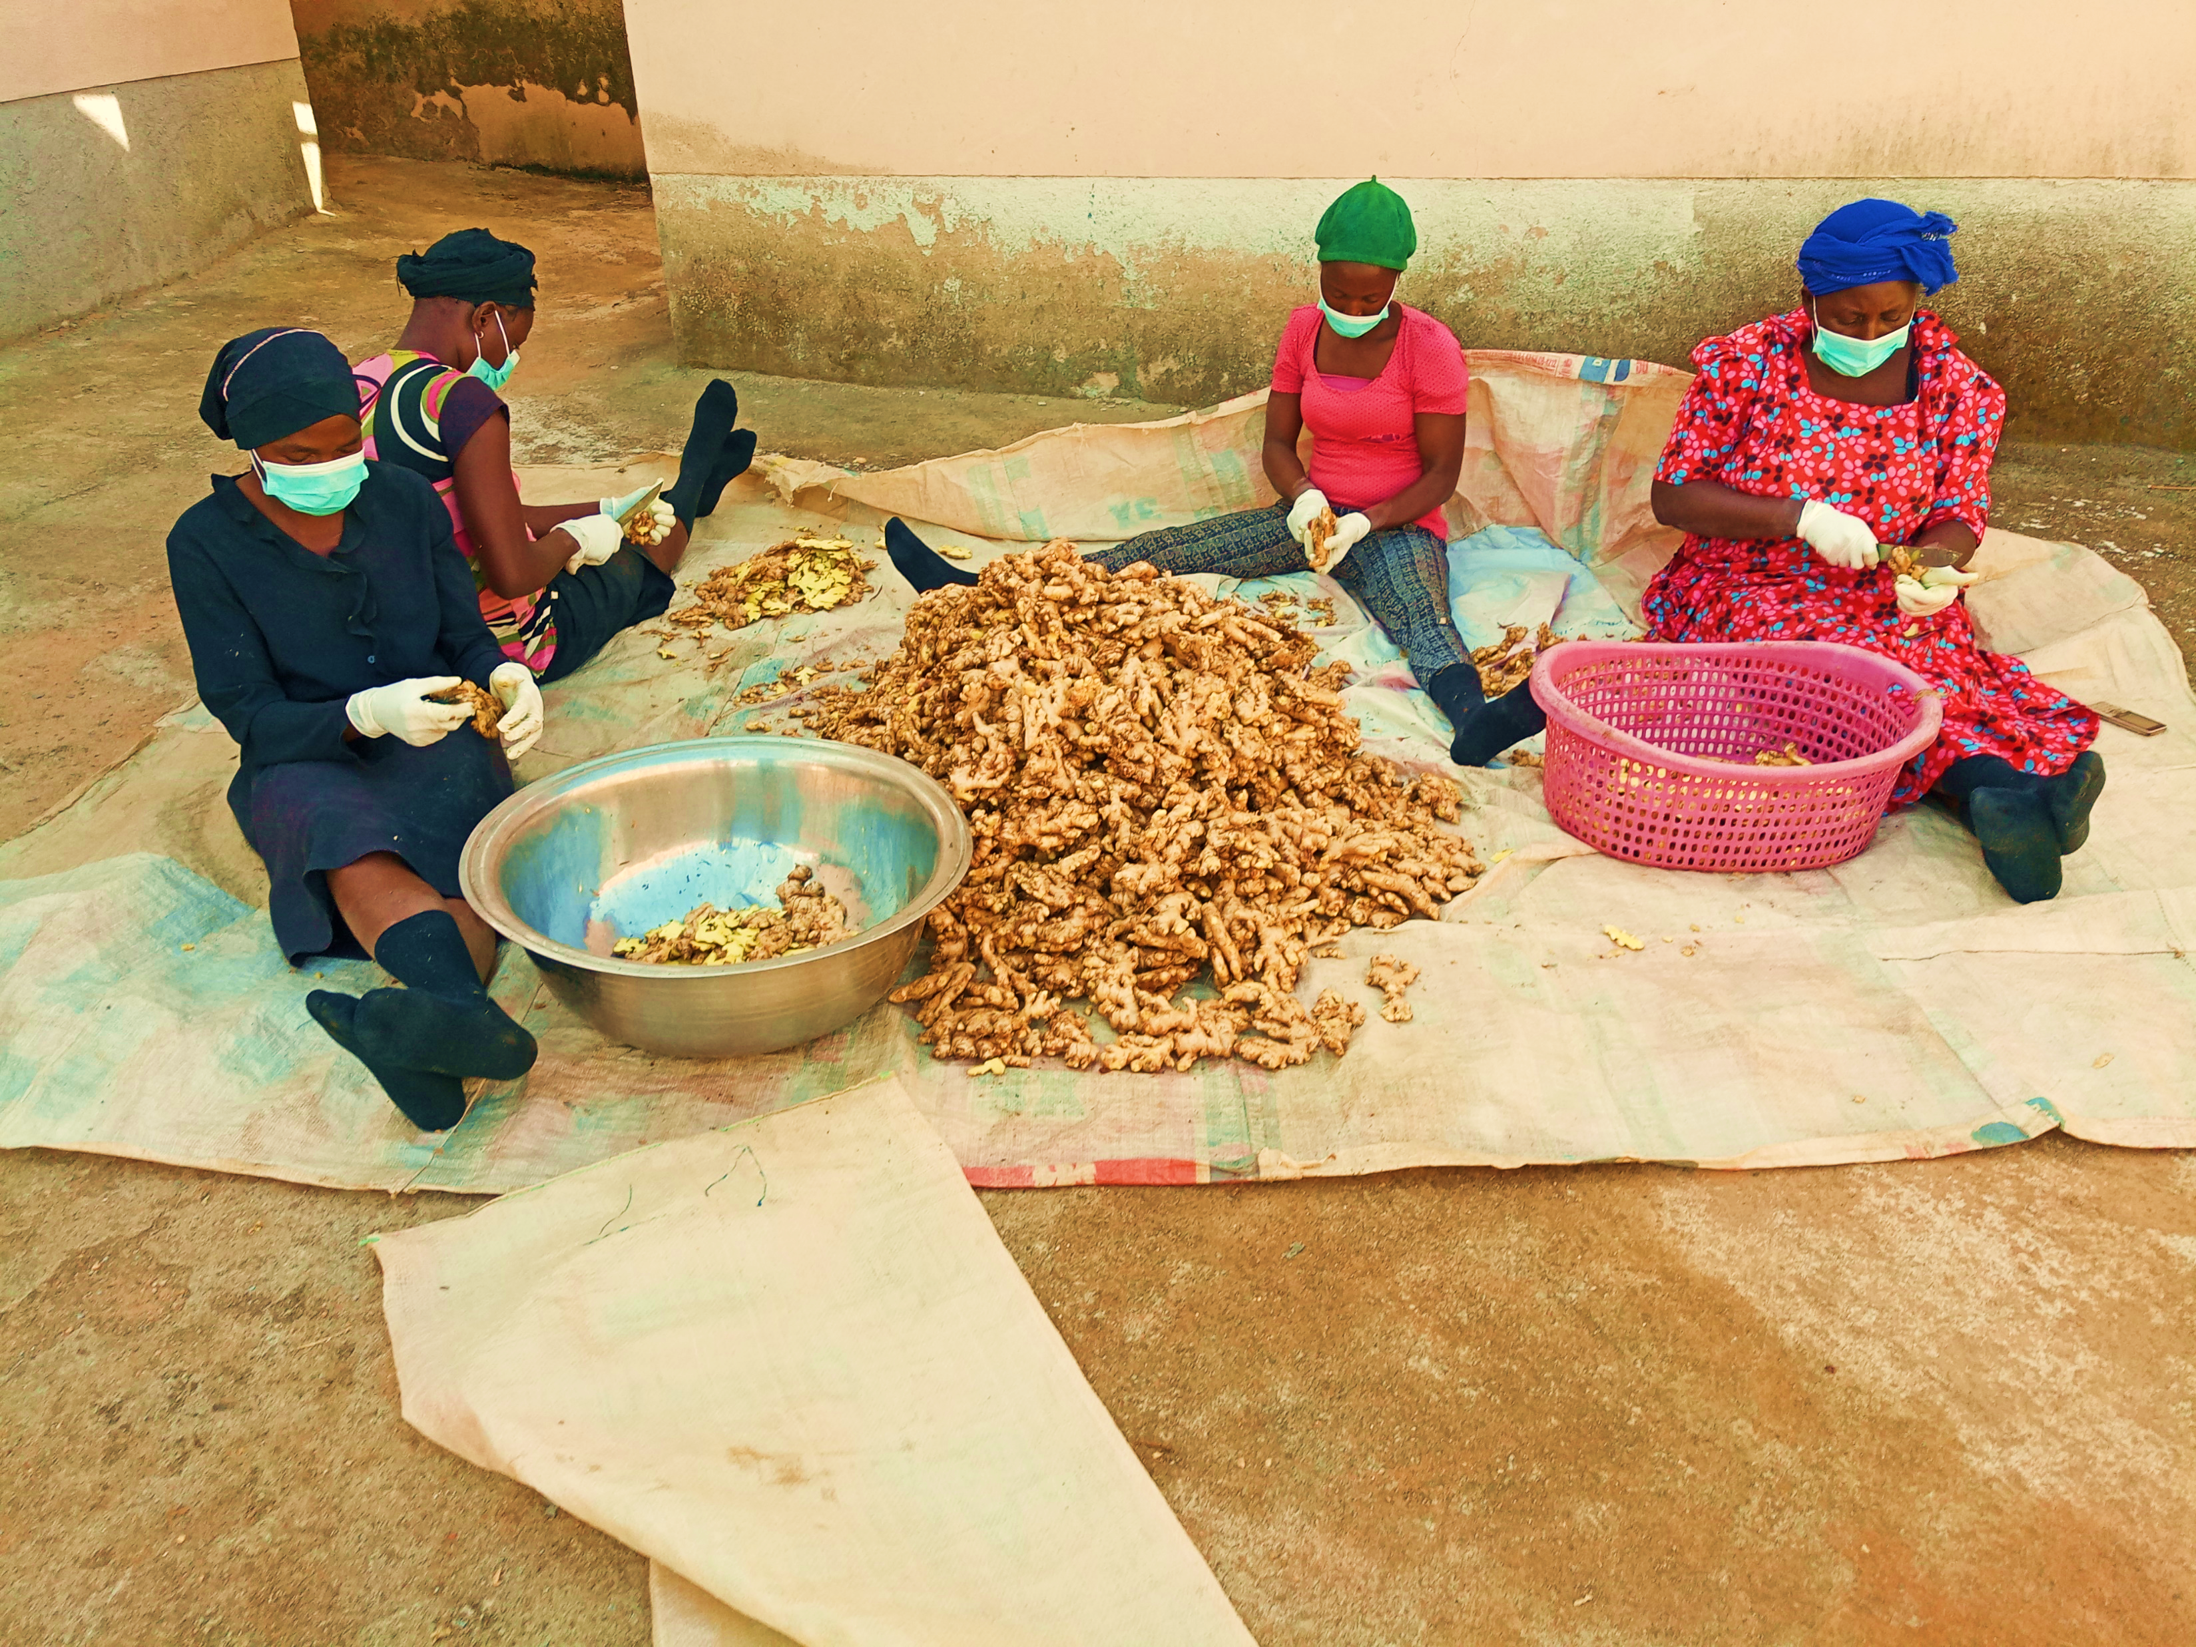
OPPORTUNITIES IN AGRIBUSINESS IN NIGERIA
THE CASE OF EXPORT OF AGRICULTURAL COMMODITIES
Notes:
A PAPER PRESENTED BY HRM ADAKU CHIDUME-OKORO AT 54TH AAC, ABUJA ON 9TH OCT. 2024

Slide 2
HISTORY OF AGRO COMMODITIES EXPORT TRADE IN NIGERIA
From Nigeria's independence in 1960, agricultural commodities export was the pillar of the countries economy: contributing about 67% of the countries GDP and providing employment for millions of Nigerians workforce.
In fact, between 1960 and 1969, the agricultural sector accounted for an average of 57% of Nigeria's GDP and generated around 64.5% of export earnings. This highlights the critical role agriculture played in Nigeria's economy during that period.
Some key agricultural commodities exported by Nigeria during that time included:- cash crops: such as cocoa, rubber and cotton. Food crops: like groundnuts, cassava, and yams. Livestock products: including leather, hides and skins.

Slide 3
HISTORY OF AGRO COMMODITIES CONT’D
With the major focus of the Country’s export trade then were Cocoa coming from the Western Region, Palm oil from the Eastern Region and Groundnuts from the Northern Region
The 1970s oil boom transformed Nigeria's economy, with oil and gas exports surging to over 95% of export earnings and more than 80% of federal government revenue
The negative consequences of the oil boom and dependence, resulted in neglecting agriculture and manufacturing, with resultant widespread poverty

Slide 4
NIGERIA’S AGRICULTURAL PRODUCTS RESOURCES
Nigeria is blessed with three different climatic zones namely: Tropical zone in the South, Guinea Savannah in the middle belt and semi arid Sudan/Sahel in the North.
These different climatic zones support the production of various types of Agricultural and environmental products.
Nigeria is richly endowed with agricultural resources, and the sector plays a vital role in the country's economy. Major Agricultural Products include:- Maize, Cassava, Guinea Corn, Yam, Groundnut, Livestock Resources are also abundant, with Cattle, Goats, Sheep, Poultry, Fisheries and Aquaculture contribute significantly to Nigeria's agricultural sector as well.

Slide 5
NIGERIA’S AGRICULTURAL PRODUCTS RESOURCES CONT’D
In terms of Agricultural commodities, these include Cocoa, Cashew, palm kernel cake, cassava chips, bitter kola, medicinal herbs, horticultural products, Irvinger (Ogbono), Vegetables, Grains of Paradise (Alligator Pepper), cola nuts etc in the tropics.
Through Ginger, sesame seeds, chillies, soya beans, orange peel, shea nuts, shea butter, groundnuts, etc in the Guinea Savannah in the middle belt.
to Hibiscus flower, Gum Arabic, stone flower, Cassia Tora seeds, neem seeds, frankincense, etc in the semiarid and Sahel North. Nigeria stands out as a global melting point for Agricultural commodities export.

Slide 6
WORLD MARKET OUTLOOK FOR KEY AGRICULTURAL COMMODITIES PRODUCED IN NIGERIA
The Table below shows the world market outlook for some of the commodities produced in Nigeria.
As people of the world return to nature by preferring to consume natural products, there is an impressive forecast of the growth rate of the global demand for virtually all the agricultural products from Nigeria.
The forecast growth rate for the world demand for Nigeria’s agricultural products means that there are vast opportunities in the global market place for Nigeria’s agricultural commodities.
These opportunities become more pronounced following the growing trend of the preference of oversea manufacturers to source their raw materials from origins rather than through overseas middlemen.

Slide 7
TABLE SHOWING THE WORLD DEMAND AND GROWTH RATE FORECASTS FOR NIGERIA’S KEY AGRICULTURAL COMMODITIES
SN | PRODUCT | WORLD TRADE 2022 US$m | WORLD TRADE 2023 US$m | ANNUAL GROWTH FORCAST (CAGR) | REMARKS
1 | Ginger | 4,300 | 4,500 | 5% From 2024 to 2032 | Fuelled by its widespread us in food, beverages and pharm industries
2 | Hibiscus Flower | 115 | - | 7% Over the next 5 years | Driven by the rise in the demand of herbal teas and natural health products
3 | Soybeans | 62,000 | 67,000 | 4% From 2024 to 2028 | Driven by increasing consumption of animal products, plant based protein and expanding biofuel industry
4 | Cocoa | 13,460 | 14,200 | 5% From 2024 to 2028 | Driven by growing popularity of dark chocolate, consumer awareness of health benefits of cocoa and strong demand from emerging economies
5 | Cashew nuts | 7,500 | 7,820 | 3.31% From 2024 -2029 | Driven by strong demand for nuts in the food and confectionary industries
6 | Sesame seeds | 5,300 | 5,700 | 6% Five year forecast From 2024 | Market is driven by rising interest in plant based diets, expansion in emerging markets and innovations in the food industry
7 | Cassia Tora Seeds | 90 | 98.48 | 8.92% Five year forecast from 2024 | Demand is fuelled by its increasing demand for plant based products in the food and animal feed industry and as a cheap source of natural thickener in the cosmetics and textile industries
8 | Hides & Skins | 90,000 | 100,000 | 6.1% Five year forecast | Market is powered by increasing demand of hides and skin by luxury fashion, automotive upholstery and footwear industries

Slide 8
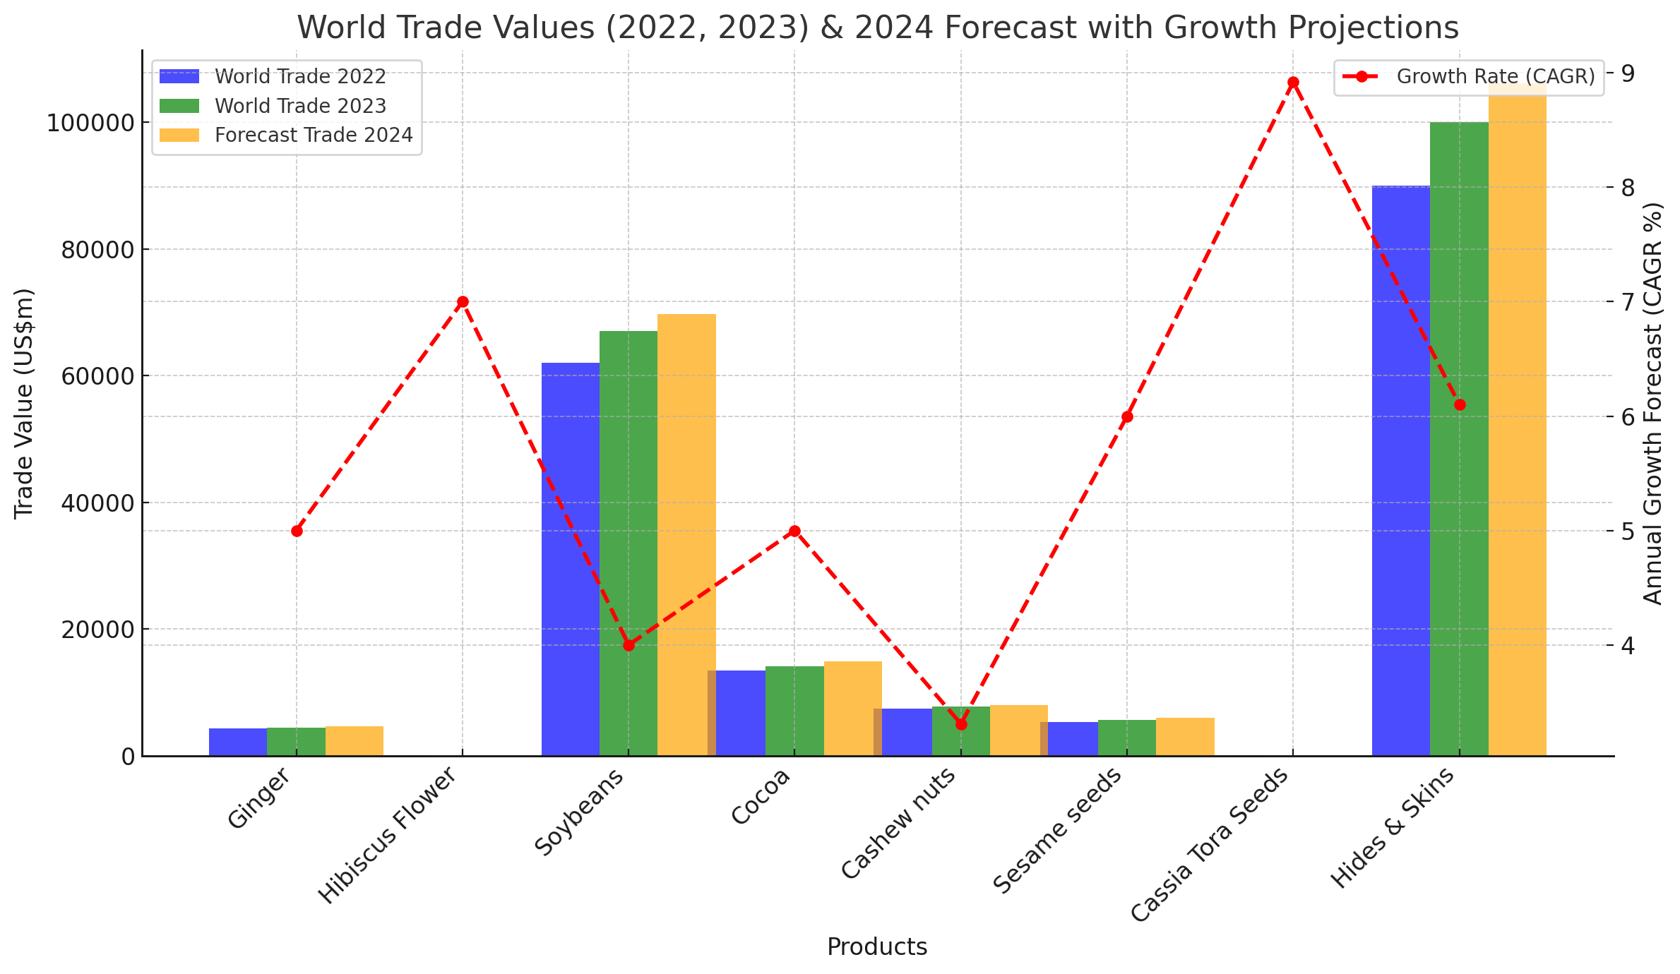

Slide 9
EXPORT OPPORTUNITIES FOR NIGERIA’S PRIMARY AND VALUE ADDED AGRO COMMODITIES
Virtually all the primary agro commodities produced in Nigeria have openings for new and innovative Exporters and businessmen and women in the value chain of each of the commodities. The products include but not limited to the commodities listed in the Table above.
The return to natural and plant based products, the rising global demand and growth rates for all agro commodities ascertains a sustainable demand for Agro commodities of which Nigeria is a key producer.

Slide 10
PRIMARY PRODUCTS
Bitter kola Fresh Ginger
Dried kolanuts Dried Split Ginger
Bush mango Shea nuts
Palm kernel cake Shea butter
Soybeans Charcoal
Prosopis Juliflora Hibiscus Flower
Chai seeds Acacia Gums
Fonio seeds Cassia Tora Seeds
Cashew nuts Orange peels
Cocoa Stone flower
Groundnuts Frankincense
Chilli
Dried Split Tumeric

Slide 11
EXPORT OPPORTUNITIES FOR NIGERIA’S PRIMARY AND VALUE ADDED AGRO COMMODITIES CONT’D…; VALUE ADDED INTERMEDIATE PRODUCTS.
Ginger Powder
Chilli Powder Gum Arabic Powder
Turmeric Powder De-hauled sesame seeds
Hibiscus Tea cuts Essential oil
Colours
Flavours
Ginger Tea cuts
Hibiscus Syrup
Ginger concentrate
Ginger Paste
Ginger Oil
Ginger Biscuits
Shea butter
Cocoa Butter
Peanut butter
Bush mango powder
Multi seed cleaning and polishing

Slide 12
BASIC PRE-REQUISITES FOR ENTRY INTO AGRICULTURAL COMMODITIES EXPORT BUSINESS.
Registered Limited Liability Company
Registration with the Nigerian Export Promotion Council
Basic knowledge of the products you want to export eg. Quantity produced by Nigeria, basic Safety and Technical data of the product to be exported.
Understanding of export processes, packaging and documentation requirements
Understanding of basic accounting
Understanding of international Food Safety standards of the products you wish to export.
Certification of your export products (at a later stage)
Acquisition of trading capital and basic export operations infrastructure
Understanding the value chains of the commodities you wish to process and export
Attaching to a Mentor for handholding.

Slide 13
WHERE YOU GET EXPORT ORDER CONTACTS
Social Media Handles (Facebook, Instagram,Twitter, LinkedIn)
Your Website
Trade Exhibitions
Referals
Search Engine Optimization (SEO)
Email Marketing
Content Marketing (Blogs, Articles, Videos)
Online Communities
Print Advert
Radion & Television
Out door Advertising

Slide 14
WHY CHOOSE NON OIL EXPORTS AS A BUSINESS SECTOR TO OPERATE IN?
Agricultural business was the first business Enterprise that God ordained, with creation.
With humanity still in existence, food is required for sustenance, the business can not go out of vogue. Food will continue to be relevant as long as there is life.
Export Expansion Grant (EEG) by FGN through NEPC
Income Tax Exempt by the FGN through The Federal Inland Revenue Service.
Obtaining trading funds at a Single digit interest rates by development Banks & impact Investors.
Opportunities for attracting International funding by various international Donor Agencies.
Earnings & income is in foreign Exchange.
Helping the Nigerian Economy to earn scarce foreign exchange.
You will be helping to create jobs for Nigeria’s teaming population.

Slide 15
AGRO EXPORT HARD FACTS
Agro Commodities Export is capital intensive.
Not a Part Time Business Venture
Requires your total focus, commitment & attention
Operator must be a maximum Risk Taker
Not an all commers Business
Not for the feeble hearted
Extremely important to watch commodities cycles to avoid loses.

Slide 16
THANK YOU

Slide 17
THE END

