Slide 1
54th ANNUAL ACCOUNTANTS CONFERENCE- GOVERNANCE REIMAGINED Agribusiness Value Chain

Slide 2
Dr. Jide Adedeji
Academic Director Agribusiness Management Program
jadedeji@lbs.edu.ng

Slide 3
Brief Profile of Dr Jide Adedeji

Slide 4
Introduction
Academic Director Agribusiness Management Program at the Lagos Business School
Research and Executive Education focus is on Transformation, Value addition, Value creation in Agricultural Commodities and raw materials
Work in Postgraduate and Executive Education in Agribusiness
AgMP- Executive Program
Module 1-Strategic Thinking and Value Chains (Virtual Program)
Module 2-Entrepreneural and operational excellence (On Campus)
Module 3-Field Trip (Visit Farms and Factories)
Agribusiness Elective in FTMBA, MMBA, EMBA, MEMBA
Consulting and Solutions Providers in Agribusiness Innovations and Technology Implementation
This is a Challenge, Try Us!

Slide 5
Nigeria Agriculture Overview
Nigeria relies on $10 billion import to meet its food and agricultural production shortfalls mostly wheat, rice, poultry, fish and food services
Sector is affected by inadequate food processing, storage, preservation, post harvest loss and a lack of financing and infrastructure.
01
04
02
Consumer oriented foods are imported from Europe, Asia, USA, South America and South Africa
05
These challenges have exacerbated food inflation. Food inflation rose to 23.75% in December 2022.
The sector is affected by regular flooding, desertification of crop and grazing land, extremist insurgencies, and conflicts between herdsmen and local farmers.
Devaluation of the Naira, higher fuel prices and insecurity have also contributed to rising food prices as transportation costs increase.
03
06

Slide 6
Agriculture Value Chain
A value chain in agriculture describes a range of activities and sets of people that bring agricultural products from production in the field to final consumption, where value is added at each stage to the product
A value chain will have a pre-production, post production, industrial production, processing agro inputs, seeds, fertilizers, tillage operations, harvest, direct sales, food and product preservation, product packaging and transportation
Value chains are interrelated and activities at one level impacts others in positive and negative ways

Slide 7
Agriculture Value Chain
Agriculture which is the act of farming is different from the agribusiness.
The typical agribusiness value-chain can be separated into four broad activity sectors; pre-upstream, upstream, mid-stream and the downstream sector
Pre-upstream: This deals basically with research institution, seed, land management and the management/control of pest and diseases.
Upstream – This is the beginning of the value chain (direct farming and cultivation across the crops, livestock, forestry and fishery sector).
Downstream – This constitute the distribution/logistics/export of value-added products/import of tools, equipment, preservatives, chemicals & fertilizers.
Mid-stream – This is the manufacturing/processing/packaging/tool fabrication & design/sales and marketing…etc

Slide 8
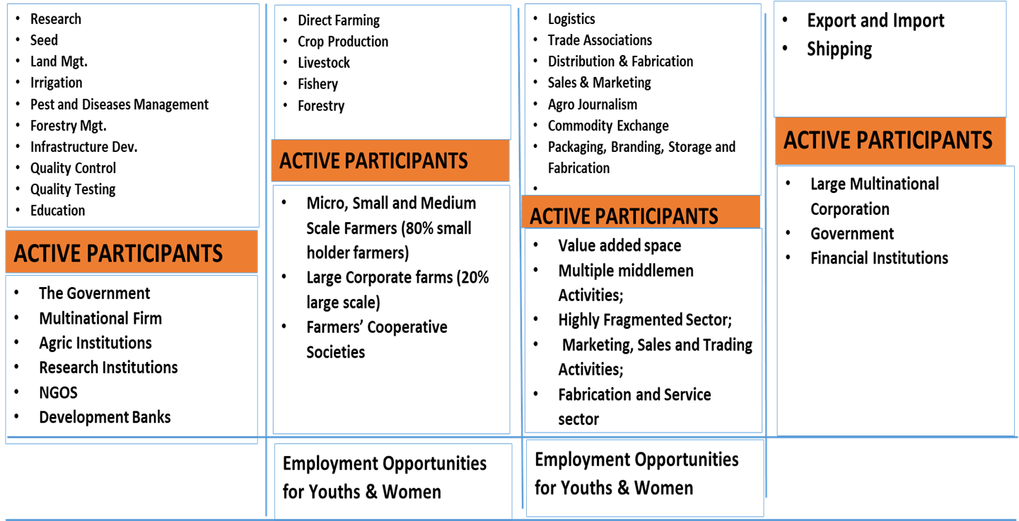
Agribusiness Value Chain
Requires huge sunk cost
& technical knowledge
Requires huge sunk cost

Slide 9
Value Chain Analysis
Value chain analysis examines and analyze a production unit or process in a market chain, from input suppliers to final buyers and the relationship among them
Value chain analysis looks at the factors influencing performance, including access to and the requirements of end markets, the legal, regulatory and policy environment; coordination between firms in the industry and level and quality of support services
Value chain analysis helps to understand overall trends of industrial reorganization and identify change agents and leverage points for policy and technical interventions.

Slide 10
Some Key Value Chains In Nigeria

Slide 11
Global Cocoa Beans Production

Slide 12
Global Palm Oil Production

Slide 13
Global Rice Production

Slide 14
Agricultural Exports

Slide 15
Total Value Agricultural Export

Slide 16
Major Agricultural Export Crops
 | AGRICULTURAL COMMODITY | 2023 (NAIRA BN) | 2022(NAIRA BN)
1 | Superior Quality Cocoa Beans | 258.5 | 200.2
2 | Sesame Seeds | 253.7 | 139.86
3 | Soya Beans (excluding Seeds) | 120.1 | 9.1
4 | In Shell Cashew Nuts | 109.93 | 66.4
5 | Std. Quality Cocoa Beans | 99.71 | 32.6
6 | Other Cut Flowers | 86.7 | 15.6
7 | Shelled Cashew Nuts | 84.2 | 21.0
8 | Flours & Meals Soya Beans | 63.2 | 203M
9 | Natural Cocoa Butter | 35.32 | 15.57
10 | Soy Bean seeds | 28.06 | 6.84
The Agricultural sector has seen increase in export of its top commodities. Nigeria exported Agricultural goods of 1.23 trillion in 2023, a 53% increase from 583 billion in 2022.

Slide 17
Agro Export Reimagined
Agribusiness is critical to our Food security, productivity and competitiveness.
6
Agroeknor exporting Hibiscus Flowers, we are changing that with new offerings of Hibiscus Cordials, Drinks and various Teas and products for exports
1
5
2
4
3
This current system was designed for us, to serve as suppliers of raw materials and commodities for value addition in Europe etc
The re-imagination begins with the question, What are they doing with these raw commodities we are exporting?
We have complied diligently for over 5 decades exporting our raw materials without Value addition
We then employ technologies to create and add value and compete on the global marketplace

Slide 18
Hibiscus Cordial

Slide 19
Hibiscus Cordial Packaging

Slide 20
Key Tool Of Value Addition

Slide 21
Keys For Product Development Success
Understand Trends
Customer Feedback/Input
Agile Development
Unique Value
Collaborative Culture
Continuous Learning and Improvement
Product Development in Emerging Markets

Slide 22
Funding And Investment Solutions
Inadequate and Ineffective Bank participation in Agribusiness
Little to no Funding of local Start-ups, innovators and SMEs
Operations based on Depositors' funds
Funding to Foreign companies and multinationals that export their profits
Banks are Licensed to collect money, they have a responsibility
Use a rating system to not fund small business, entrepreneurs and innovators
Use a dual Credit rating for local agribusinesses

Slide 23
Funding Solutions
Invest in small business innovators
Create access to financing, capital and expert financial advice
Increase access to venture capital
Grants and Concessionary loans to Small businesses and SMEs
Grants and Concessionary loans to Rural community businesses
Banks must create a 2-tier rating system for loans to Indigenous and local small businesses and SMEs
Engage experienced even retired experts to mentor, advise and consult with innovators and SMEs

Slide 24
Productivity Solutions
Establish Small Business Administration for mentors/Mentee relationships, Peer-to-Peer learning opportunities, Network of Agribusiness practitioners to collaborate
This will lead to a complete transformation of our Rural communities and increased GDP
6
1
One million acre Irrigation facility for all Northern states for cultivation Corn, Sorghum, millet and tomato
5
One million seedlings grants and distribution of Cocoa/Cashew seedlings to farmers in all South west states
2
One million Yam/Cassava sets grant and distribution to farmers in the Middle belt
4
One million seedlings grant and distribution of oil palm/Cashew seedlings to farmers in all South East states
3

Slide 25
Close The Expertise Gap
Create a Small business/ SME advisory body
Captain of Industry and Mentoring Service
Innovation hubs and Venture incubators
Invest in skills acquisition and ethics
Educate and skill up agriculture extension agents

Slide 26
Food Insecurity
Russian invasion of Ukraine

Slide 27
Food Security Solutions
The major problem is lawlessness in the land
There is low productivity
Banditry in the Northwest
Religious unrest and Islamic terrorists in the North East
Kidnappings in the Middle Belt and spreading
Farms are in remote areas and farmers work in isolation thereby vulnerable to attacks, kidnapping for ransom
Warlords and local bandits are demanding payments for farmers to operate their farms or harvest their crops

Slide 28
Agribusiness Value Chain In Forestry
The forestry sector takes up about 1% of the agricultural sector's GDP
The sector requires long-term investment as the tree crop life cycle ranges between 7 and 50 years.
An example of the opportunities within the tree crop value chain can be seen in the forward and backward linkages in the PULP tree sector.
1001 industries have forward or backward linkage to the Pulp tree or forest product value-chain in Nigeria
Products linked to the pulp are presented below.

Slide 29
The Pulp Tree or Forest Product value Chain in Nigeria
Paper making Chemical
Forest Fire prevention
Harvesting Machinery
Chainsaw Blade
Logging
Consulting Engineering
Pulp
Sawmill
Machinery
Silviculture
Wood
Chips
Pulp and Paper Machinery and Equipment
Sawmills
Cork
Paper
Diapers
Sanitary Products
Recycling
Printing
Building Materials
Other Wood
Products
Paperboard Paper packaging
Prefabricated
Houses
Wood
Furniture
Internationally Un-competitive Industries
Weak Link
Moderate Link
Source: Monitor Company (1994) and Porter, Solvell, and Zander (1991)
Strong Link

Slide 30
Paper products, tissue papers, wipes, diapers, sanitary products, paperboards, pre-fabricated wood, paper-making chemicals, corks (for corking wine) and wood furniture are all linked to the Pulp Tree
These products are currently imported given the un-competitiveness of Nigeria’s forest tree value chain.

