Slide 1
Sustainable Nation Building through Revitalization of Social Contract
54th Annual Accountants’ Conference: Governance Reimagined – Mapping the Future
October 2024
Akinyele Kolawole Oladeji
CSDC Consulting

Slide 2
Outline
1
Introduction: The Social Contract - What it is, What it Means
2
Indicators of a voided Social Contract
3
Suggestions for Rebuilding a Sustainable Nation via Social Contract
4
Conclusion

Slide 3
Introduction

Slide 4
The Social Contract: What it is, What it Means?
A persons’ moral and/or political obligations are dependent upon a contract or agreement among them to form the society in which they live.
According to thinkers like Jean-Jacques Rousseau, John Locke, and Thomas Hobbes, the social contract defines the rights and duties of citizens and their leaders.
Citizens have certain rights and agree to certain responsibilities in exchange for the Government providing certain duties and obligations for the benefits of the citizens.

Slide 5
The Social Contract: What it is, What it Means Cont’d?
Social Contract
Government Duties / Obligations
Citizens Rights and
Responsibilities
Right to life and personal liberty, fair hearing, freedom of expression etc.
Right to vote and be voted for
Responsibility such as payment of taxes, maintenance of public infrastructures etc.
Secure lives and properties
Provides infrastructures such as healthcare, roads, electricity.
Enforce citizens responsibilities e.g., payment of taxes, obeying of law and order
Trust Co-efficient

Slide 6
Indicators of a Voided Social Contract

Slide 7
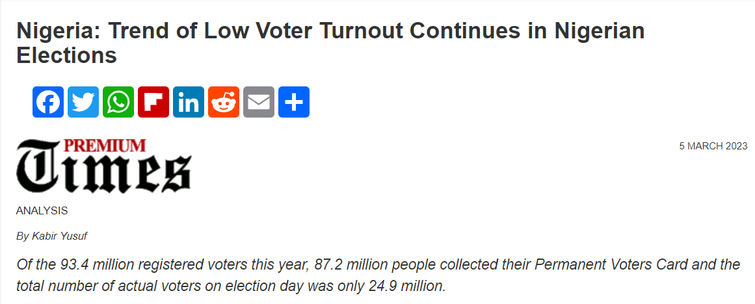
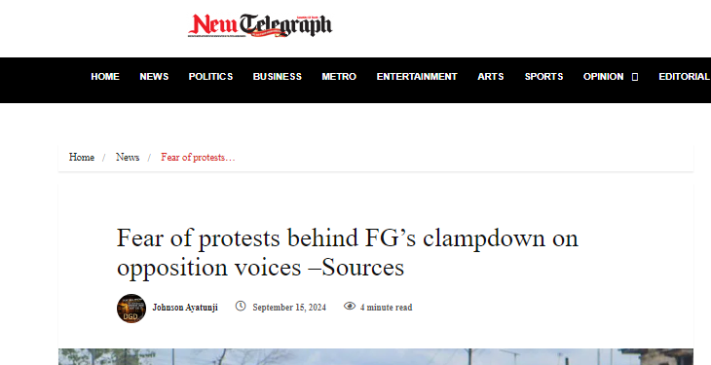
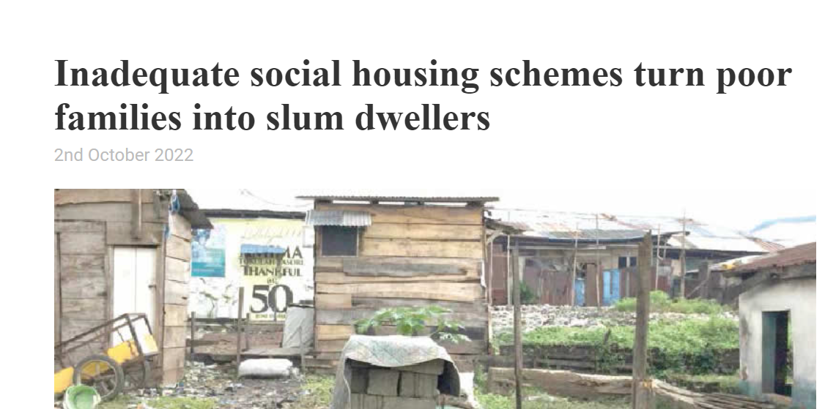
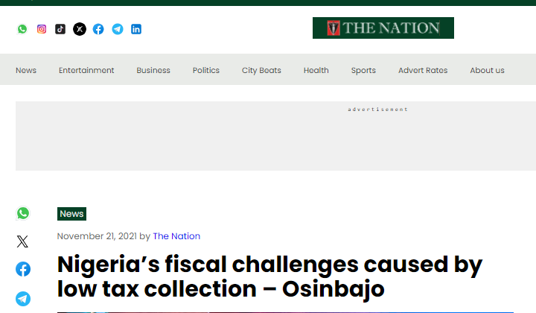
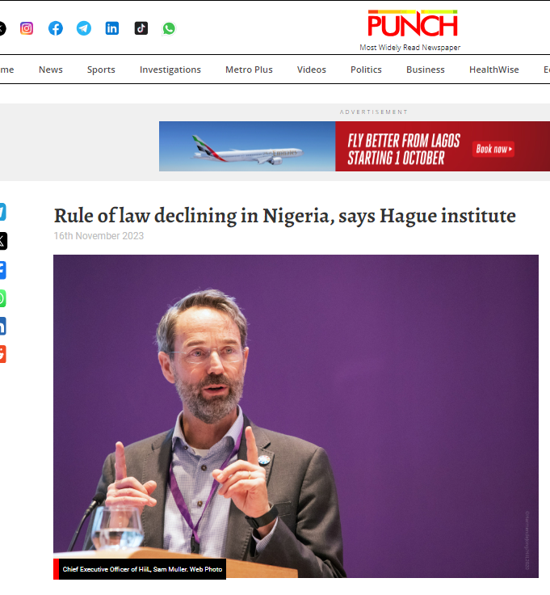
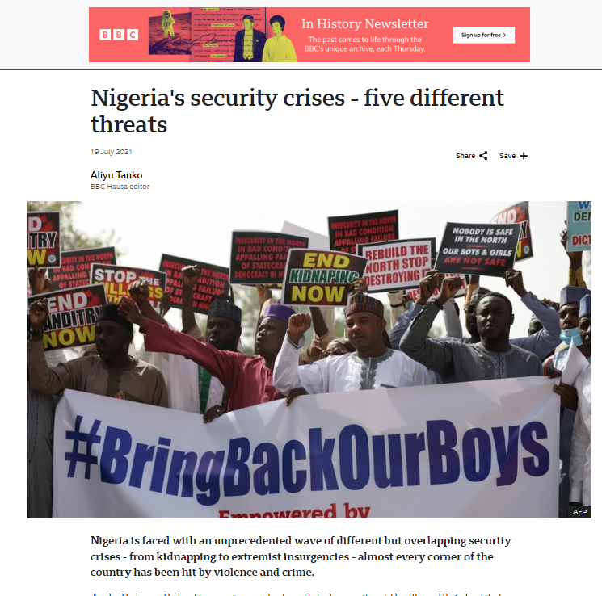
Indicators of a Voided Social Contract
As with every type of contract, if either party does not fulfil its own part of the contract, the contract is deemed legally broken or voided

Slide 8
Renegotiating a voided social contract – Case studies

Slide 9
Singapore
The Transition
Breakdown of the
Social Contract
Leadership: Under PM Lee Kuan Yew, Singapore pursued policies emphasizing racial harmony, meritocracy, and economic development.
Institutional Reforms: The government reformed institutions, invested in education, and created laws to ensured peace and stability.
Social Reform: Racial integration was enforced through housing regulations, and multiracialism was promoted as a national ideology.
Outcome of
the Transition
In the 1960s, Singapore faced political instability, ethnic tensions, and a weak economy. Ethnic violence between the Malay and Chinese populations, paired with high unemployment and poor living conditions, led to a breakdown of social cohesion.
Singapore is now one of the world’s richest countries by GDP per capita, excelling in education, technology, and governance.
The country has achieved high living standards, racial harmony, and stable political institutions.

Slide 10
Rwanda
The Transition
Breakdown of the
Social Contract
Social Reform: After the genocide, Paul Kagame's leadership prioritized unity, justice, and reconciliation.
Institutional Reforms: Rwanda implemented Gacaca courts to deal with the large number of genocide perpetrators, while strengthening its formal judiciary to restore the rule of law.
Economic Reforms
Outcome of
the Transition
Rwanda's social contract shattered during the 1994 genocide, where over 800,000 people, mostly Tutsis, were killed by extremist Hutus. The genocide left a society deeply divided along ethnic lines, with destroyed infrastructure and a failed state.
Singapore is now one of the world’s richest countries by GDP per capita, excelling in education, technology, and governance.
The country has achieved high living standards, racial harmony, and stable political institutions.

Slide 11
Suggestions for Rebuilding a Sustainable Nation via Social Contract

Slide 12
Digitisation of Government Services
Implement e-Government platforms to streamline public services to reduce institutionalized corruption.
Invest in smart city technologies e.g., smart grids, digital water management systems to improve urban living.
Strengthening
Governance
Capacity Building
Training and retraining of government officials at all levels in effective and efficient service delivery
Promote meritocracy in recruitment into the civil and public service
Establish the right KPIs for Government and promote accountable
Institutional Reforms
All tiers of government to publish accounts or stewardship reports periodically
Review the structure of Governance to make it efficient and effective
The legislature should continue to strengthen its oversight roles
Strengthen the various ministries and MDA to execute policies and plans of Government effectively
Strengthen the local government to serve its purpose.

Slide 13
Review the Judicial System
Reform the judicial system – especially making the judiciary truly independent
Improve and enhance law enforcement
Eliminate corruption in the judiciary system
Reform outdated legislation
Strengthening the Judicial System
Modernization of Court Processes
Digitise court records and introduce e-judiciary platforms to improve efficiency.
Establish online case filing and case management systems to reduce delays.
Access to Justice
Expand legal aid programs to provide representation for marginalized populations.
Roll-out more alternative dispute resolution options to reduce the burden on the court system

Slide 14
Improve Citizen’s Engagement
Emphasize citizens education - for instance, introduce regular townhall meetings
Enforce the freedom of information in all aspects of public life - promote freedom of the press and civic society organizations
Social Equality and Development
Introduce sustainable social reforms
Enhance elections process
Invest in rapid infrastructure development
Enhance education system
Social Reforms
Public Accountability
Digitise government services
Mandate all tiers of government to publish accounts or stewardship reports
Eliminate institutionalized corruption at all levels of government.

Slide 15
Monetary and Fiscal Measures
Implement measures to aggressively reduce income inequality
Adopt the value for money approach to governance
Align monetary and fiscal policies to promote economic growth
Simplify tax administration.
Economic Reforms
Fiscal Discipline and Public Financial Management
Cutting down the cost of governance
Promote transparency in government expenditure
Industrialisation and Economic Diversification
Protect and promote MSMEs
Foster innovation and industrialization
Focus on import substitution strategies

Slide 16
Conclusion
Rebuilding the social contract is not just an abstract idea but a necessary foundation for nation-building.
As we have seen from the experiences of nations like Singapore and Rwanda, fostering unity, justice, and active civic engagement are key elements that must be prioritized.
Strengthening our institutions, bridging societal divides, and leveraging technology to ensure transparency and accountability will pave the way for a more cohesive and prosperous society.

