Slide 1
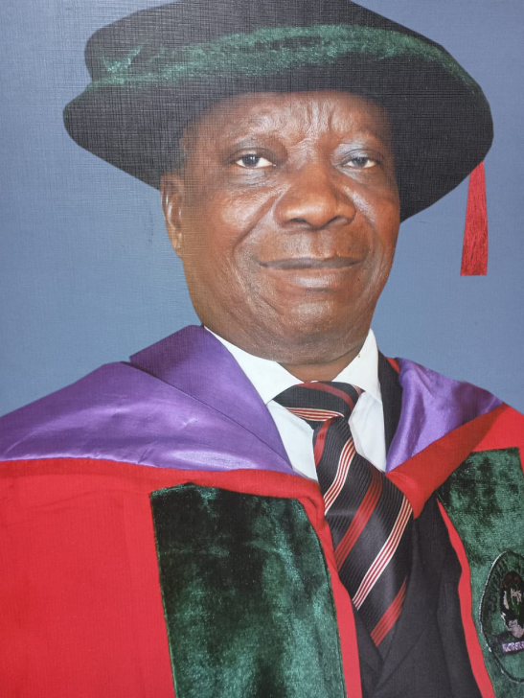
BUILDING TRUST AND CREDIBILITY THROUGH EMOTIONAL INTELLIGENCE
THE INSTITUTE OF CHARTERED
ACCOUNTANTS OF NIGERIA 77TH
INDUCTION CEREMONY PAPER
DELIVERED BY:
PROF.ADEGBIE FOLAJIMI FESTUS
(PhD,MPhil,MBA,BSc,FCA,FCTI,FCIB}
Professor of Accounting &Taxation,
Babcock University
DATE:MAY 12,2026

Slide 2
What is accounting in global sustainability AGENDA?
Accounting is the displaying of professionalism in the accurate recording and transparency in processing information about financial transactions of economic entities for economic decisions for business sustainability.

Slide 3
Who is in charge of the financials of BUSINESS/economic entities?
An accountant has the responsibility of the business and financial transactions on behalf of the business /economic entities, reports the performance to the management and issues quality and credible financial reports to the stakeholders.

Slide 4
Shroff(2015) defines reporting quality as the degree to which financial statements accurately represent a company’s underlying economic and financial performance, and reporting credibility as the level of trust investors have in the correctness of the financial statements.

Slide 5
WHAT IS A BUSINESS ENTITY?
A business entity is a legal structure with ownership stake, provides goods and services to the economies to satisfy the needs of society, achieve its set goals to ensure maximum returns to the owners inform of dividends and capital appreciation.
In a legal entity especially when it involves companies that operate in the capital market with defined ownership structure, there is separation of power between the owners who own the business and the management who control s the assets and liabilities of the entity.

Slide 6
WHAT ARE THE ROLES OF ACCOUNTANTS TO CLIENTS?
[1] Value creations: Accountants create value by:
i. Transforming raw financial data into actionable strategic insights, optimise tax positions, ensure regulatory compliance and manage cash flow to boosts performance through profitability
ii. Offering forward looking advice, improve operational efficiency ,and strengthens internal controls to safeguard assets and build investors confidence

Slide 7
III. Leveraging technology to enhance efficiency, accurate and strategic decision making
IV. Utilising Advanced Accounting Information (AIS) ,cloud computing, automate routine tasks ,reduce operational costs ,and provide real time insights that improve business performance.

Slide 8
[2] Business Advisory: for growth and financial Planning
Accountants must apply their professional skills to analyse clients /companies financial data to identify trends, set goals ,and develop growth strategies either through expansion into new markets, diversify portfolios or launch a new product.
[3] Tax Practice for Tax efficiency and Relief Opportunities
Beyond compliance, accountants must and should identify ways to reduce tax burden through tax planning or tax aggressiveness .They must uncover opportunities tax credits, investment reliefs and deductions that will have positive effect on cash flow. There are many decided cases in the court that support accountants in managing the taxes of their organisations/clients.
Example is:

Slide 9
In Commissioner of Inland Revenue vs Duke of Westminster (1936), Lord Tomlin stated that
“Every man is entitled, if he can, to order his affairs so that the tax under the appropriate Acts is less than it otherwise would be. If he succeeds in ordering them so as to secure this result, then, however unappreciative the commissioners of Inland Revenue or his fellow tax payers may be of his ingenuity, he cannot be compelled to pay an increased tax.

Slide 10
[4] Technology and Process Improvements for Bookkeeping
Modern /Digital Accountants leverage cloud-based tools like Quick Books, Xero, Sage Business cloud . to automate task, improve accuracy and save time. All these allow 24/7 remote access to financial data ,which enable real time collaboration between businesses and accountants.
Other modern technologies are:
i.AI and Machine Learning (ML)
ii. Intelligent Document Processing (OCR)-Optimal Character Recognition
iii. Robotic Process Automation (RPM)
iv. Blockchain Technology
v. integrated Payment platforms.

Slide 11
[5] RISK MITIGATION AND COMPLIANCE
Accountants will mitigate risk and ensure compliance by implementing robust internal controls (segregation of duties, authorization), conducting regular audits and reconciliations, adhering to standardized accounting frameworks like Generally Accepted Accounting Principles /International Financial Reporting Standards (GAAP/IFRS), and staying updated on regulatory changes to prevent financial misstatements, fraud, and data breaches.

Slide 12
TYPES OF ACCOUNTANTS IN THE GLOBAL ECONOMY FOR the BUILDING OF TRUST AND CREDIBILITY
There are two types of accountants that practice accounting in the global village:
[1] Technocratic Accountants:
Technocratic accountants subscribe to the idea that there is a rational approach to the best methods to accurately and fairly account for the financial doings of a client. Technocratism is the general belief that a solid technical understanding and application of accounting practices provide the best basis for handling a client’s financial records. In other words, rational rules are the best means for governing accounting practice.

Slide 13
[2] PRAGMATIC ACCOUNTANTS :
On the other side of the spectrum, there is the pragmatic school of thought. Pragmatic accountants subscribe to a broader view of accounting that relies on professional and personal judgment rather than solely on a set of rules. Additionally, the necessary judgment skills are only acquired through years of practice and experience
Note:Regardless of the specific school of thought that an accountant subscribes to, they are all still ethically and legally bound to the generally accepted accounting principles that govern how a client’s financial records are accounted for,futhermore their focus is to create value for the clients.

Slide 14
SKILLS THAT CHARTERED ACCOUNTANTS MUST POSSESS IN ORDER TO BUILD TRUST AND CREDIBILITY
Every chartered accountant must possess three skills:
[1] Professional Skill:
Showing a sound work-man’s command, and displaying specialized knowledge appreciated by clients and other professionals. Like Accountants using financial engineering and strategy reinventing which are quite distinct from what an economist is using, but appreciated by economists. This is the display of the ability as a Chartered accountant to analyze a situation in the following areas:

Slide 15
i. Knowledge of Accounting Practices. ii. Proficiency in Accounting technology(ies). iii. Ability to Prepare Financial Statements., iv. Knowledge of General Business Practices(i.eBusiness Policy & Strategy), v. Ability to Analyze Data, vi. Critical Thinking Skills.,vii. Accounting Organizational Skills. and viii. Time Management Skill

Slide 16
[2] Technical Skill:
Chartered Accountants must possess strong technical expertise in financial reporting, taxation, auditing, and data analytics, underpinned by proficiency in ERP -Enterprise Resource Planning software (e.g., SAP,-Systems,Applications,and Products in Data Planning, Oracle-Data Base Management System) and advanced Excel. Accountants must also understand regulatory standards (IFRS/GAAP), budgeting, and emerging technologies like AI, blockchain, and cloud computing

Slide 17
[3] SCIENTIFIC SKILL
Chartered Accountants (CAs) must possess scientific skills through the application of a methodical, evidence-based approach to financial analysis, investigation, and technology, often functioning as "financial scientists" or "detectives" in a business context that will give confidence to clients or the business organizations.
Companies need strong accounting leaders to translate their portion of that data into valuable insights that can help a company improve business outcomes and adjust to changing sales patterns all in real-time
These skills can be found in an accountant with a background in data analytics. Their knowledge and experience enables them to dive deep into the data and extract the value in it using SWOT analyses ,Michael Porters five forces model to gain competitive advantage by clients/businesses as shown in the diagram below:

Slide 18
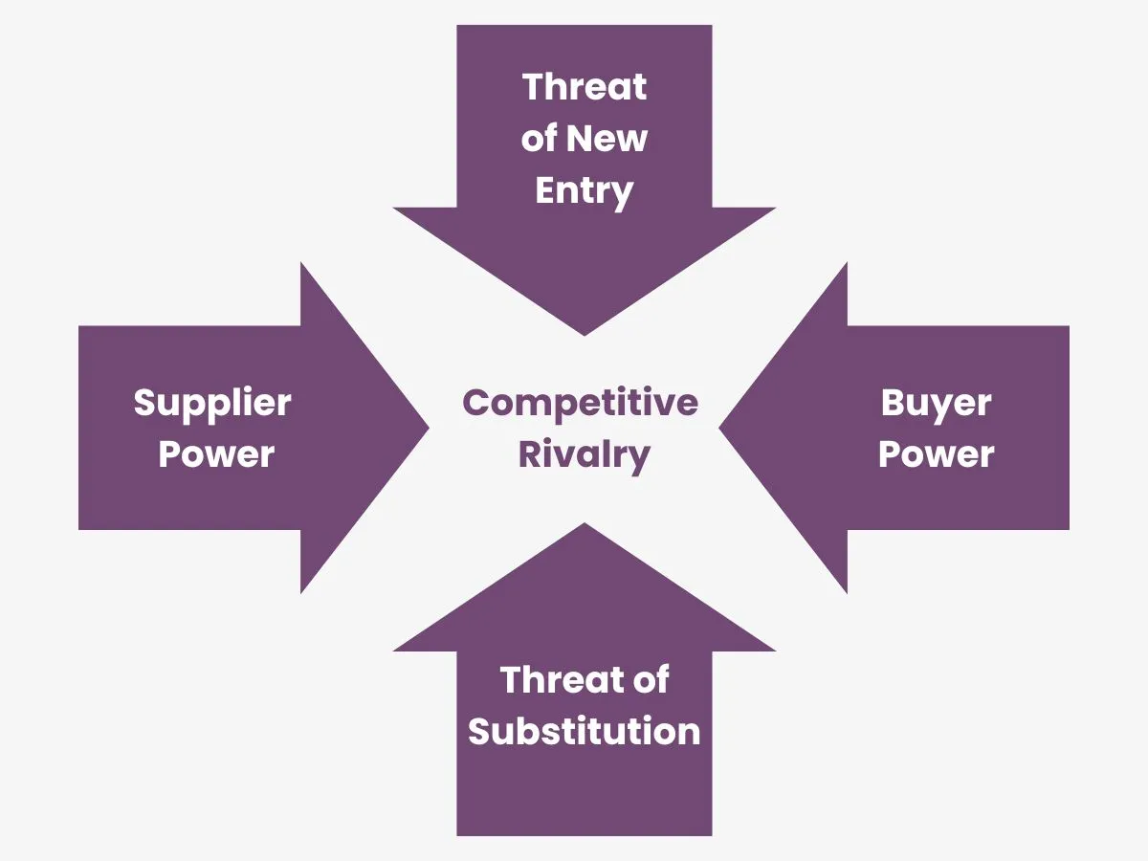

Slide 19
HOW TO BUILD TRUST AND CREDIBITY AS PROFESSIONAL ACCOUNTANTS
What is Trust?:Trust can be explained as a solid belief in an individual’s dependability, truth, or capability. Trust involves integrity, dependability, and uniformity in actions and decisions.
Larrave(2024) opined that trust is like building a sandcastle-delicate, but if you use the right tools, it can stand strong.

Slide 20
McMakin(2019) explained that everyone one in professional services holds this truth to be self-evident, [i.e a fact, truth, or statement is so obvious, clear, and apparent that it requires no proof, evidence, or further explanation to be understood.,2+2=4)]hence it is critically important that your clients trust you..
“Here is a surprising truth :one of the best ways to communicate I am trustworthy to clients and potential clients is to turn business down” (McMakin,2019:1)

Slide 21
FACTS ON TRUST
[i] Earn their trust & Show your worth: Be a successful service provider and not scoundrel [A scoundrel is a dishonest, dishonourable, or wicked person, typically a man, who behaves badly by cheating or deceiving others.]
[ii] Trust is clients impression of service providers by working with them and spending time with them. hence there is acquired knowledge by the clients
[iii] Trust is transferable: Most people are likely to stop shopping around for a service provider if they are given a referral from a trusted person. i.e I trust Mr. Greg Adetokunbo (Managing Partner ,AKJ Chartered Accountants) and if Mr. Gred Adetokunbo trusts Mrs Justinian Morris( A Chartered Accountant),then I will considered her for the tax consultancy service.

Slide 22
[iv] Protecting the best interest of the clients by looking for opportunities to demonstrate trustworthiness:
i.e tuning down business by saying “NO” to potential work that you either not qualified to do or unable to accept because there are other projects that you are handling. This establishes trust ,which will benefit you when that client needs your expertise or someone asks them for a referral in your specialty in future.

Slide 23
What is credibility ?
Credibility is the quality of being trusted, believed, or accepted as true and honest. It represents the capacity to inspire confidence in a person, witness, or message, often built through consistency, expertise, and integrity. It is critical in communication, leadership, and professional contexts to ensure impact.
Soji(2026) opined that credibility is the quality of being relied on and believed in, which is established through demonstrating competence, dependability, and honesty over time.
University of Pittsburgh (2025) averred that credibility can be direct (derived from first person experience),secondary (derived) from citing evidence),from others) and indirect (derived from effective presentation)

Slide 24
Accountants earn credibility in providing accounting services primarily through technical competence, strict adherence to ethical standards, professional certification, and the consistent delivery of accurate, reliable financial data. Credibility is built over time by demonstrating integrity in handling sensitive data and providing transparent, compliant financial reporting that helps businesses manage risks and make informed decisions

Slide 25
WHAT IS THE DIFFERENCE BETWEEN TRUST AND CREDIBILITY ?
Credibility is the objective assessment of competence, expertise, and reputation ("can I believe them?"), whereas trust is a subjective, emotional judgment of character, integrity, and reliability ("can I rely on them?"). Credibility is built through credentials and results, often earning initial respect, while trust is built over time through consistent behaviour, fostering deeper long-term relationships
McMakin (2019) stated that credibility comes from the head while trust comes from the heart.

Slide 26
HOW DO PROFESSIONALS/ORGANISATIONAL LEADERS BUILD TRUST AND CREDIBILITY?
[1] Act with Integrity: Professionals must align actions with values and commitments for building a reputation of trustworthiness and reliability; be transparent and honest in all communications in order to strengthens trust and credibility.
[2] Grow connections: Building trust and credibility require professionals to practice open communication, active listening ,empathy[the active, conscious effort to understand, feel, and share another person's emotions and perspective],and extend trust to others.

Slide 27
[3] Model Consistency: A Professional Practice Model (PPM) is a structured, schematic framework that defines how professionals deliver ,care, embodying their values, theories, and goals. Here leaders/professionals must establish clear expectations and guidelines, demonstrate reliability in decision—making and be predictable in behaviour and respinses ,all which foster stability and reliability
[4] Build Capability: Professionals who continually enhance their skills and knowledge inspire confidence in their confidence in their ability to lead effectively and navigate challenges.. Professionals build capability by consistently developing skills, knowledge, and behaviours through formal training, hands-on experience, and mentoring. This process involves setting clear, actionable goals for growth, utilizing professional development strategies, and aligning learning with strategic business needs to enhance performance.

Slide 28
The Institute of Chartered Accountants of Nigeria (ICAN) builds capability through a rigorous, multi-tiered professional examination syllabus, mandatory continuing professional development (MCPD) programs, and specialized training, ensuring members meet global accounting standards. It strengthens competence through technical workshops, mentoring, and ethical training while promoting practical experience .
Having passed the professional examination, Chartered accountants must attend the MCPD, workshops and Annual Accountants Conference for development on contemporary issues to enhance professional competence.

Slide 29
[5] Deliver Results: Trust is ultimately solidified when consistent, high-quality results are delivered. Leaders who achieve objectives and produce meaningful outcomes build a track record success that enhances their credibility and inspires trusts in their leadership capabilities. They must set ambitious yet achievable goals, they must monitor progress and adjust strategies as needed, and they must communicate achievements and outcomes effectively.

Slide 30
[6] Navigate Challenges and Proffer Solutions:: Though there are clear benefits of building trust and credibility with others, there are many challenges to navigate. A leader navigates challenges and proffers solutions by adopting a proactive, empathetic, and strategic approach that balances immediate crisis management with long-term organizational health. Effective leadership involves remaining calm under pressure, cultivating high emotional intelligence, and leveraging collaborative problem-solving to turn obstacles into growth opportunities

Slide 31
“Trust is not built overnight but grows through sustained effort and genuine engagement with others. Leaders who consistently demonstrate these principle strenghtens their credibility and inspire others to contribute their best to shared goals and aspirations”(Soji,2026)

Slide 32
Therefore I say to you all ,grow trust, practice trust ,protect trust because trust is an asset that will grow and preserve wealth.Likewise,
Practice credibility because it is the currency of trust that separates reliable leaders from unreliable leaders.

Slide 33
TRUST AND CREDIBILITY IS A FUNCTION OF EMOTIONAL INTELLIGENCE
What is Emotional Intelligence ?:Emotional intelligence (EI ) is the ability to perceive, understand, manage, and utilize emotions effectively in oneself and others to guide thinking and behaviour. It involves self-awareness, empathy, and social skills to navigate complexities, reduce stress, and improve relationships. In the business world emotional intelligence is emotional quotient (EQ), social intelligence, interpersonal intelligence, and empathy

Slide 34
Smyth (2025) averred that trustworthy leadership thrives on emotional intelligence, where authentic communication, emphatic decision-making, and emotional resilience during uncertainty inspire loyalty and collaboration.
London School of Business Administration (2026) declared that:” In contemporary organisational environments characterised by rapid change, diverse workforces, and increased complexity, leadership effectiveness extends beyond technical expertise and strategic competence. While analytical skills and operational efficiency remain essential, emotional intelligence plays a decisive role in shaping leadership success.

Slide 35
POWER OF EMOTIONAL INTELLIGENCE:
Trust and Credibility =f( Emotional Intelligence)
Emotional Intelligence is measured by:
Self-Awareness and Consistency
Empathy and Understanding
Fairness in Decision-Making
Effective Conflict Management.
Therefore, Trust and Credibility =f( Self-Awareness &Consistency, Empathy and Understanding, Fairness in Decision-Making, Effective Conflict Management)

Slide 36
[1] Self-Awareness and Consistency::
Self-awareness and consistency involves recognising and understanding our own emotions, strengths, weaknesses, and how they can affect others. By being in tune with our emotions, we can effectively manage them ,which will lead to healthier interactions with those around us. Leaders who understand their own emotional triggers are less likely to respond impulsively(often driven by emotion). Predictable and measured behaviour strengthens credibility

Slide 37
[2] Empathy and Understanding:
Empathy and understanding by leaders involve accurately recognizing, interpreting, and sharing the emotions and perspectives of others to build connection and trust. It combines cognitive (knowing), affective (feeling), and compassionate (acting) elements to grasp why people feel and act as they do, fostering better relationships and, in leadership, creating psychologically safe environments. Therefore open communication reduces uncertainty and mitigates misunderstandings.

Slide 38
[3] Fairness in Decision –Making:
Fairness by leaders is the using of self-awareness, empathy, and emotional regulation to treat others justly, impartially, and without bias. It requires managing emotions to ensure decisions are reasonable, fostering trust, and balancing personal feelings with objective, equitable treatment. This approach strengthens conflict resolution and ensures equitable, respectful interactions. Fairness enhances organisational trust. Leaders who consider emotional and relational implications alongside strategic objectives are more likely to maintain team confidence. Trust is not established through position but through consistent relational integrity.

Slide 39
[4] Effective Conflict Management.
Conflict is inevitable in organisational settings. Differences in perspective ,workload pressures, and competing priorities often generate tension. Effective conflict management involves acknowledging emotions, listening actively, and finding collaborative solutions by applying the following techniques:
Listen actively to all perspectives
Identify underlying emotional drivers
Facilitate respectful dialogue
Seek mutually beneficial solutions.
Rather than escalating dispute ,emotional intelligence leadership transforms conflict into opportunities for growth and learning.

Slide 40
WHY LEADERS MUST ADOPT EMOTIONAL INTELLIGENCE FOR BUSINESS SUSTAINABILITY
Research has shown the following benefits of practicing emotional intelligence for trust and credibility in organisations:
Increased team performance
Improved decision making
Increased personnel well-being
Reduced staff turnover
Decreased occupational stress
Increased leadership ability.

Slide 41
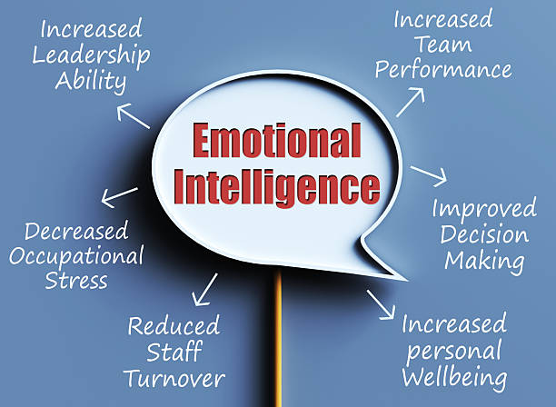

Slide 42
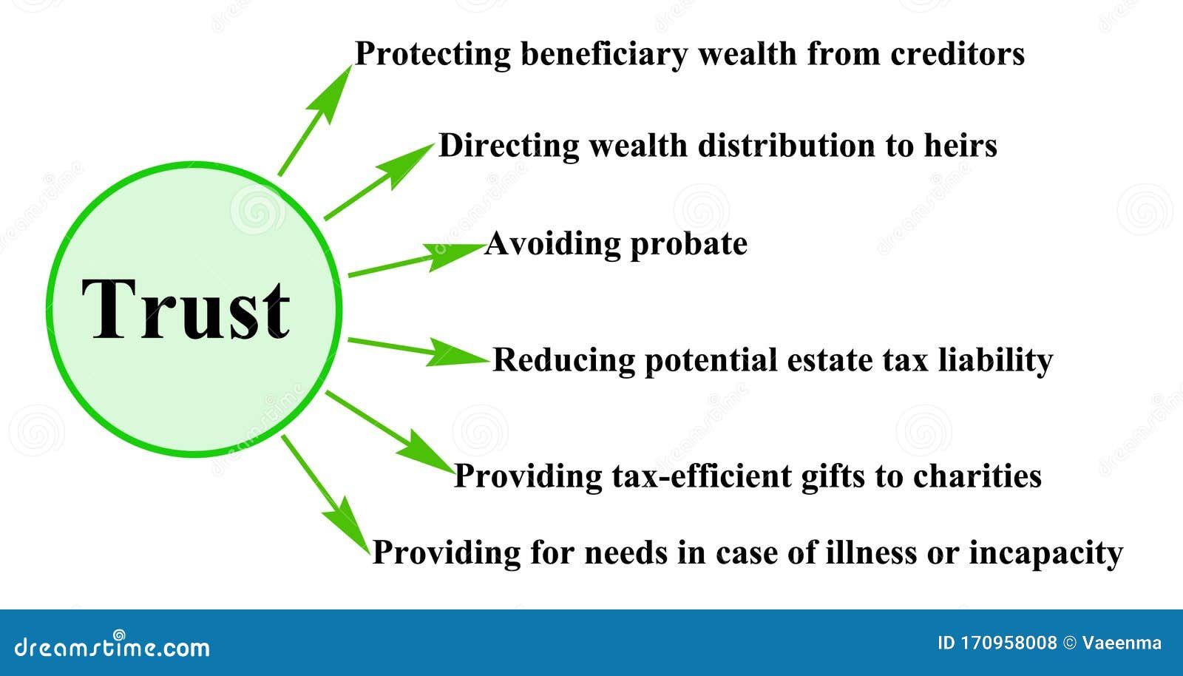

Slide 43
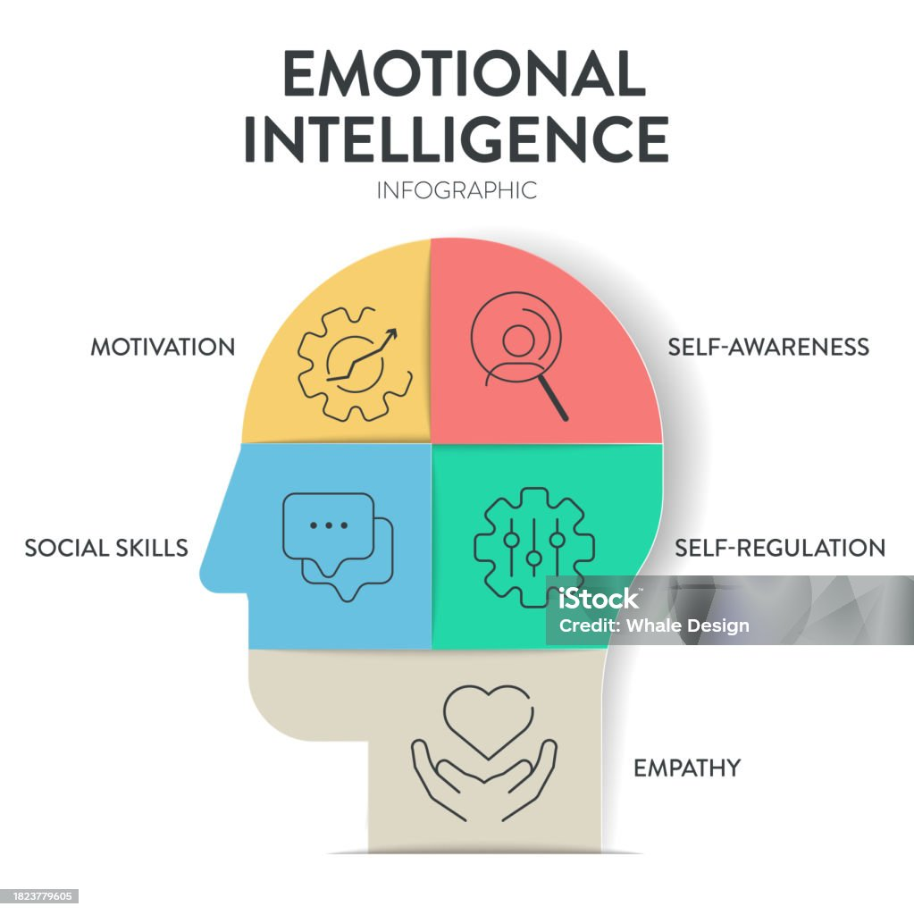

Slide 44
IN CONCLUSION
Emotional intelligence influences trust and credibility. Trust and credibility are essential for organizational success, acting as the foundation for high-performing teams, improved employee engagement, and sustainable business relationships. They increase innovation, reduce transaction costs, attract talent, and secure the social license to operate. Without them, organizations suffer from low morale, high turnover, and poor reputation

Slide 45
Emotional intelligence is established characteristics of effective leadership in modern organisations. While technical expertise and strategic acumen remain important, the ability to manage emotions, foster trust, and inspire motivation distinguishes exceptional leaders from competent managers. In environments marked by uncertainty and diversity, emotional intelligent leadership creates stability, engagement, and sustained performance. By cultivating self-awareness, empathy, and relational competence, leaders not only drive organisational success but also build cultures grounded in trust and mutual respect. Hence, emotional intelligence transforms leadership from a position of authority into a source of meaningful influence. THANK YOU

Slide 46
References
David,M.E.(2024).Emotional intelligence:The engine of trust and innovation in the most trusted companies.European Journal of Accounting,Finance & Business ,12(2),90-101.ISSN:2344-102X
Larrage,k(2024).Top 5 tips for instantly building trust using emotional intelligence. https://www.forbes.com/councils
London School of Business Administration (2026).Emotional intelligence in leadership:Driving team motivation and trust. https://londonsba.org.uk/blog/emotional-intelligence-in-leadership-driving-team-motivation-and-trust
Shroff,N.(2015).Real effects of financial reporting quality and credibility:Evidence from PCAOB regulatory regime. https://www.lse.ac.uk/accounting/assets/Documents/LSELUMSMBS-Conference/1-SHROFF-Real-Effects-of-Financial-Reporting-Quality-and-Credibility-PP.pdf
Soji(2026).Leasrning & change-Trust and Credibility. Https://soji.com.au/trust
Smyth,L.W(2025).The power of emotional Intelligence in cultivating trust. https://lornawestonsmyth.com/power-emotional-intelligence-cultivating-trusT
University of Pittsburgh (2025).Credibility. https://www.comm.pitt.edu/credibility

