Slide 1
Data Analysis for Social Impact
ICAN
IT CONFERENCE
April 2023

Slide 2
Contents
Facilitator Profile
Introduction and Course Objectives
Adeleke is a senior member of the Data & Analytics domain across EY West Africa. He has over 8 years of professional experience spanning different industries. The last 4 years of his career have been focused on the Financial Services Industry. He has a Bachelor’s degree in Economics from the prestigious Olabisi Onabanjo University and several professional certifications.
Overview of Data Analysis
Data Analysis Methods and Types
Data Analysis Process
Improving Social Impact through Data Analysis
Core Social areas in Nigeria and Data driven recommendations
Adeleke Abimbola
Senior Data & Analytics Consultant
EY
adeleke.abimbola@ng.ey.com
Q & A
Page 2
Data Analysis for Social Impact

Slide 3
Introduction and Course Objectives
Page 3
Data Analysis for Social Impact

Slide 4
Introduction and Course Objectives
Introduction
The Institute of Chartered Accounts of Nigeria (ICAN) is holding its annual Information Technology conference and the theme for this year's seminar is 'DATA SCIENCE AND ACCOUNTING PROFESSION’.
Several topics relating to the above theme will be discussed, one of which is 'Data Analysis for Social Impact'. The world is becoming more and more data-driven, with endless amounts of data available to work with. This topic discusses how data can be analyzed to gain insights into improving the social welfare of Nigerians and the world at large.
Objective
The objectives of this course are:
To learn how to leverage data to achieve a qualitative and quantitative analysis of social welfare programs
To learn how to develop data-driven decisions and more effective action plans as regards social welfare programs.
Using data to measure social programs' adoption and success rate.

Slide 5
Overview of Data Analysis
Page 5
Data Analysis for Social Impact

Slide 6
What is Data Analysis
Let's start by defining 'Analysis’. It’s a noun meaning detailed examination of the elements or structure of something. It is the process of studying or examining something in an organized way to learn more about it.
Data analysis can be defined as the practice of working with data to glean useful information, which can then be used to make informed decisions. It is the process of collecting, modeling, and analyzing data using various statistical and logical methods and techniques.
Governments and Organizations today need every edge and advantage they can get. Thanks to obstacles like rapidly changing markets, economic uncertainty, shifting political landscapes, finicky consumer attitudes, and even global pandemics, organizations today are working with slimmer margins for error.
Data Analysis helps reduce the risks inherent in decision-making by providing useful insights and statistics, often presented in charts, images, tables, and graphs.
2018
2025
175 ZB
More than 5 billion people interact with data daily. By 2025, it is expected to reach 6 billion (75% of the world’s population), and every connected person is expected to have at least one data interaction every 18 seconds.
The greatest advantage of data analysis is that there's already a huge proliferation of data and this significant and growing volume of data is available to the government at every level.
33 ZB

Slide 7
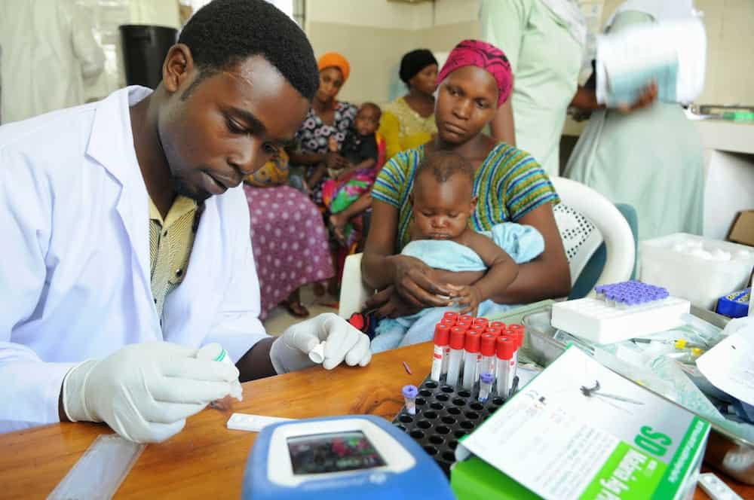
Data Analysis Methods and Types
Page 7
Data Analysis for Social Impact

Slide 8
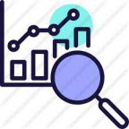
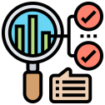
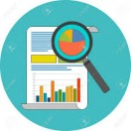
Data Analysis Types
There are 5 fundamental types of data analysis that are currently in use. It's important to make a distinction between types and methods because they're often used interchangeably, methods refer to the various ways data analysis is used.
1 | Diagnostic Analysis
Diagnostic analysis answers the question, “Why did this happen?” Using insights gained from statistical analysis, analysts use diagnostic analysis to identify patterns in data. Ideally, the analysts find similar patterns that existed in the past, and consequently, use those solutions to resolve the present challenges hopefully.
2 | Predictive Analysis
Predictive analysis answers the question, “What is most likely to happen?” By using patterns found in older data as well as current events, analysts predict future events. While there’s no such thing as 100 percent accurate forecasting, the odds improve if the analysts have plenty of detailed information and the discipline to research it thoroughly.
3 | Prescriptive Analysis
Mix all the insights gained from the other data analysis types, and you have prescriptive analysis. Sometimes, an issue can’t be solved solely with one analysis type, and instead requires multiple insights.
4 | Statistical Analysis
Statistical analysis answers the question, “What happened?” This analysis covers data collection, modeling, interpretation, and presentation using dashboards. The statistical analysis breaks down into two sub-categories:
Descriptive: Descriptive analysis works with either complete or selections of summarized numerical data. It illustrates means and deviations in continuous data, percentages, and frequencies in categorical data.
Inferential: Inferential analysis works with samples derived from complete data. An analyst can arrive at different conclusions from the same comprehensive data set just by choosing different samplings.
5 | Text Analysis
Also called “data mining,” text analysis uses databases and data mining tools to discover patterns residing in large datasets. It transforms raw data into useful business information. Text analysis is arguably the most straightforward and direct method of data analysis.

Slide 9
Data Analysis Methods
Although there are many data analysis methods available, they all fall into one of two primary types: Qualitative Data Analysis and Quantitative Data Analysis.
Qualitative Data Analysis
Quantitative Data Analysis
The qualitative data analysis method derives data via words, symbols, pictures, and observations. This method doesn’t use statistics. The most common qualitative methods include:
Content Analysis: for analyzing behavioral and verbal data.
Narrative Analysis: for working with data culled from interviews, diaries, and surveys.
Grounded Theory: for developing causal explanations of a given event by studying and extrapolating from one or more past cases.
Statistical data analysis methods collect raw data and process it into numerical data. Quantitative analysis methods include:
Hypothesis Testing: for assessing the truth of a given hypothesis or theory for a data set or demographic.
Mean, or average: determines a subject’s overall trend by dividing the sum of a list of numbers by the number of items on the list.
Sample Size Determination: uses a small sample taken from a larger group of people and analyzed. The results gained are considered representative of the entire body

Slide 10
Data Analysis Process
Page 10
Data Analysis for Social Impact

Slide 11
Data Analysis Process
Step 1
Step 2
Step 3
Step 4
Step 5
Step 6
Increase Rating Requirements
Data Collection
Increase Rating Requirements
Plan the Increase of Rating / Scope
Data Visualization
Publish Data set as Bronze
Data Processing
Data Interpretation
Data Requirement Gathering
Data Analysis
Define your scope
Define straightforward questions, answers to which you need to make a decision
Define measurement parameters
Define your unit of measurement. e.g. Time, Currency, etc.
Gather data based on measurement parameters
Collect data from different sources
Keep a log of the collection date and source of data
Organize your data to make sure to add side notes.
Validate data with reliable sources
Convert data as per the scale of measurement defined in step 1.
Data cleaning is done at this stage to improve the quality of data.
Exclude irrelevant data
Perform sorting, plotting, and identifying correlations in data
You may need to modify your question, redefine parameters, and reorganize your data as you manipulate the data.
Use data analysis tools and software to help you derive conclusions based on requirements.
Review if the result answers your initial questions
Review if you have considered all parameters for making the decision
Review if there is any hindering factor to implementing the decision
Choose data visualization techniques to communicate the message better. These visualization techniques may be charts, graphs, color coding, and more.

Slide 12
Improving Social Impact through Data Analysis
Page 12
Data Analysis for Social Impact

Slide 13
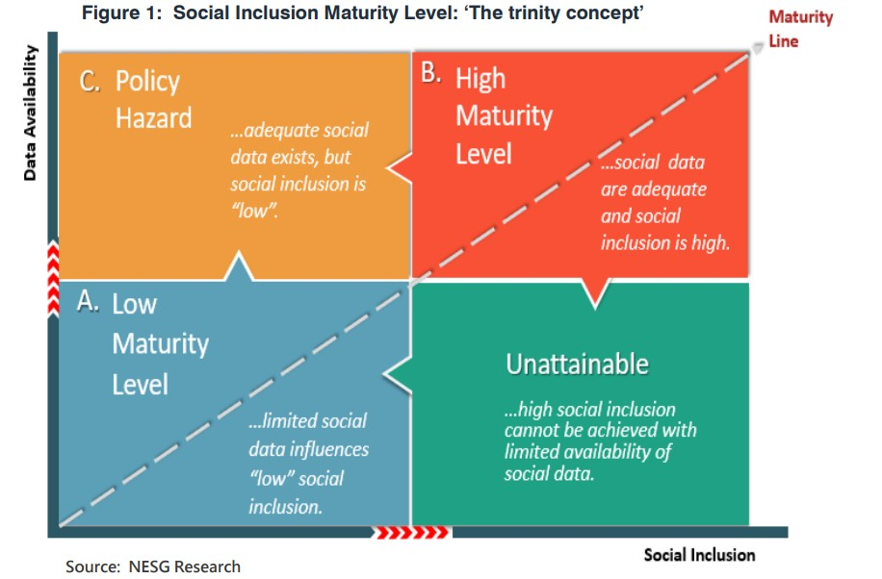
Why Data matter for Social Inclusion
Greater access to and use of data aids the development of strategies and formulation policies that address social inclusion. The role of policy, therefore, in mediating the interaction between data availability and social inclusion cannot be undermined. As shown in Figure 1, data-driven policies constitute a critical pillar for achieving high social inclusion. The figure depicts the positive relationship between data availability and the level of social inclusion.
Quadrant A: This quadrant depicts the low maturity level/pedestrian region, where limited social data preclude social inclusion. In this quadrant, policy-making processes are affected by inadequate social data.
Quadrant B: The quadrant explains the high maturity level/sophistication region, where there is a high level of social indicators (data) that influences a high level of social inclusion as leveraged by the effective policy. In this quadrant, it is assumed that data is used and considered in the policy-making process.
Quadrant C: It explains the policy hazard or data redundancy region, where adequate social data exists, but social inclusion remains “low.” This reflects total neglect of data in formulating social inclusion policies. Here, there are low data-driven social inclusion strategies.
Unattainable Region: This region buttresses the point that high social inclusion cannot be achieved with limited availability of social data. Here, effective policies cannot be made without adequate data.

Slide 14
There is a broad spectrum of potential use cases to unleash the benefits of data analysis across social sectors
Data is being used across various key government verticals to drive policy decisions, increase efficiency, ensure better governance, and improve social impact
Delivery of public and social services
Defense
Counter terrorism
Education
Health
Understand citizens’ sentiment and develop new services according to needs
Provide personalized and targeted delivery of services
Detect fraud, waste and abuse
Improve performance of military departments
Use predictive analytics to prevent possible threats
Watch and monitor borders and navy and air spaces using real-time data
Identify potential terrorist behaviour using data on conversations, transactions etc.
Detection of data patterns to report possible cases of extremism and crime
Optimizes educational programs and courses to get the most value from available resources
Better assessment of teachers and teaching methods
Facilitates parent-teacher communication
Identify cohorts at greater risk and initiate targeted wellness programs
Monitor disease outbreak and take measures to control it
Fraud detection in medical claims
Examples of Data Analysis Use Cases
Cybersecurity
Law enforcement
Environment & natural disasters
Tax services
Transportation
Monitor the network
Flag suspicious actions
Protect critical infrastructure from cyber attacks
Predict and prevent crimes and ensure safety
Support criminal investigations
Enable local and state governments to work jointly
Predict occurrence of natural calamities and determine optimal response
Better evacuation planning and coordination
Identify and respond to tax evasion and avoidance
Tailor services to specific taxpayer groups to make it easier to comply
“Nudge” taxpayers to file their returns accurately
Traffic planning and management
Understand hot spots for traffic accidents
Predict pollution levels using traffic data
Page 14
Data Analysis for Social Impact
Notes:
https://www.datasciencecentral.com/profiles/blogs/top-12-data-science-use-cases-in-government
https://www.intellectyx.com/big-data-analytics-in-government-how-the-public-sector-leverages-data-insights/
https://www2.deloitte.com/us/en/insights/industry/public-sector/government-trends/2020/predictive-analytics-in-government.html

Slide 15
Core Social Areas in Nigeria and Data-Driven Recommendations
Page 15
Data Analysis for Social Impact

Slide 16
Social Economic issues in Nigeria
Nigeria's Human Development Index (HDI) value is 0.539 and its ranked #161 of 189 countries in the world. This puts them in the low human development category. Nigeria's life expectancy is 54 years (compared to a global average of 73). However, in the last two decades, Nigeria's life expectancy increased by almost 10 years, and years of schooling increased by over 1 year. Still, major social development problems in Nigeria are Poverty, Inequality, Inaccessible healthcare, Unemployment, Substandard or non-existent education, and Insecurity. These problems form barriers to social development progress.
Poverty
According to a report by the National Bureau of Statistics (NBS), 40% of Nigeria’s population, or almost 83 million people, live below the country’s poverty line of 137,430 naira per year (2019). The people living in the Northern region and rural areas of Nigeria were confirmed to be the poorest according to research.
This is correlated with differential access to infrastructure and amenities. This incongruence is compounded by the fact that oil revenue is poorly distributed among the population, with higher government spending in urban areas than in rural.
Inequality
Inequality is the gap in living standards between the rich and poor. Nigeria's inequality is measured by the Gini Coefficient, the distribution of income across a country. Nigeria's Gini coefficient was 35.1 in 2020, ranking it as moderately unequal. This means there's a strong gap between the rich and the poor. Although Nigeria has a strong oil-producing economy, most of the money is kept within companies. This means there is a lack of funding for infrastructure such as housing and schools which would help Nigerians in poverty.
Education
Nigeria's literacy rate, a percentage of the population that can read and write, is low (around 62.02% according to world bank data in 2018). Compared to the UK's literacy rate of 99%. This is due to a lack of educational facilities, textbooks, and teachers in the country. This is a negative indicator for Nigeria as it prevents people from being able to take up higher employment for better incomes.
Further, almost half of all female children in Nigeria do not have an opportunity to get an education. This is due to cultural differences, where women's education is not as highly valued. This can further widen gender inequality as boys have more access to schooling and employment opportunities later.

Slide 17
Social Economic issues in Nigeria cont’d…
As Nigeria's population only continues to expand, the social development problems could worsen. It's predicted that by 2050, the youth population alone could be 830 million, and Nigeria is set to be one of the top 5 most populous countries in the world. In order to address social development problems, a clear set of social development goals in Nigeria is crucial. Nigeria has formed its goals along with Sustainable Development Goals (SDG), a set of goals adopted by the United Nations in 2015 to end poverty, protect the environment, and ensure peace by 2030. These goals are meant as a guide for countries to follow to make more significant changes in their countries.
Healthcare
Government expenditure on health is considerably slimmer than what comes from private contributions, differing by over two billion naira. About three percent of Nigeria's GDP is invested in the health sector, considerably below the average spending on healthcare among OECD countries. Also, OECD member countries are mostly high-income countries, whereas Nigeria is an emerging economy and belongs to countries with lower middle income. Nigerians usually have to pay for medicine out of their own pocket. Often, the medicine is expensive and difficult to afford. In 2019, on average, health care made up six percent of Nigerian household spending, with higher figures in rural areas than in urban zones.
Unemployment
Unemployment is another social issue affecting Nigeria. As of the second quarter of 2021, Nigeria's unemployment rate was 33.3% according to the National Bureau of Statistics. The unemployment rate for men was 35.2%, while the unemployment rate for women was 31.2%. The unemployment rate has been rising in recent years. The Nigerian definition of unemployment includes those who did not work at all or worked for less than 20 hours a week. The underemployment rate is also high at 22.8%.
Insecurity
The Boko Haram terrorist group in Nigeria is strictly against Western culture, including voting, dressing in Western clothes, and secular education. Their means of fighting against these cultural differences is by kidnapping, attacking, and killing people, communities, and different religious groups. Unfortunately, 35,000 people have died since 2011 from their attacks.
In addition to incessant cases of banditry and kidnappings in the northwest and parts of the southwest. The southeast continues to witness unrest resulting from separatist agitations.

Slide 18
Data-driven Recommendations
1. Understand your portfolio at a more granular level
For policymakers, leveraging data and social impact analytics can help to get a clearer picture of who and what is funded as well as the outcomes of that funding. You can reveal trends, overlaps, and gaps in how resources are distributed.
Getting a more granular view of your programs allows you to identify and root out bias and find missed opportunities. It can also give you the insights you need to expand your efforts and build effective new programs.
2. Create clearer standards and taxonomies
In the world of social impact, too often we’re talking about the same things but using different language. This can make it difficult to see where our work overlaps with others’ work and make comparisons across similar programs.
For instance, when government agencies all use different language to talk about the same issues, it’s much harder to make connections between their work.
3. Track outputs and outcomes more clearly
Social services are all about the impact. Are the programs you run creating the outcomes you intended? No matter what your budget is, if you don’t know this, you won’t know if your program is making a meaningful difference.
Data analysis can help to more accurately track the effects of social services. You can make connections between the resources you dedicate to a program, the short-term outputs it creates, and the longer-term outcomes that are achieved.
4. Find gaps in funding
Analyzing data can help the government identify gaps in its funding. Are you underfunding certain populations? Are you overlooking some components of the work? Digging into the data can help you find opportunities to do more.
Using data analysis, you can identify gaps in funding in your programs or the social sector at large. Too often prevention and infrastructure don’t get the attention they deserve.

Slide 19
Data-driven Recommendations cont’d…
5. Make new connections
It’s easy to overlook all the ways that subjects and identities overlap and intersect. But these insights can make a huge difference in how social programs are designed.
Using data analysis, the government can identify opportunities to connect different topics or projects. With data visualization tools, you can see where connections already exist and you can find places where connections should exist but don’t yet.
6. Place your program into the broader landscape
Many organizations and individuals are working to solve the same set of problems. Frameworks like the United Nations’ Sustainable Development Goals can help provide a high-level understanding of how your work fits into broader efforts to make a change, but it doesn’t give you the details you need.
You want to get a clear picture of how your programs are contributing to progress on a bigger scale. Are you helping to move the needle? Do your programs replicate other efforts or are you fulfilling a unique role? Data analysis can help you get these answers and allow you to be more strategic in the distribution of resources.
7. Evaluate program effectiveness and cost
Part of being a policymaker is balancing program cost and effectiveness. You want to know that your resources are making the changes you want to see, but also that they’re doing so as efficiently as possible.
The stakes are high. We’re not talking about some bottom line or shareholder dividends. Your program costs often determine how many people or community organizations you can support.
Data analysis empowers policymakers to get a deeper analysis of how outputs and outcomes are linked and how they compare to costs. If you don’t have this information, it’s impossible to know whether you’re making smart investments.
8. Ease the burden on Administrators
With an increasing awareness of the administrative burden often placed on government officials, data analysis can be an incredible tool to illuminate opportunities for government to lessen the load.
It means that many government organizations are often redoing the same work over and over again when it comes to social programs. Government can standardize its data management process to ensure that everyone is asking for the same information in the same format. Based on research, this can save up to 39% of the time and resources spent on organizing data.

Slide 20
Conclusion
Data analysis is a powerful tool that can be used to gain insights into social issues affecting Nigeria.
Policymakers, NGOs, and other stakeholders can use data to design policies and programs that address these social issues and make a positive social impact in the country.
Q & A

Slide 21
EY | Building a better working world
EY exists to build a better working world, helping to create long-term value for clients, people and society and build trust in the capital markets.
Enabled by data and technology, diverse EY teams in over 150 countries provide trust through assurance and help clients grow, transform and operate.
Working across assurance, consulting, law, strategy, tax and transactions, EY teams ask better questions to find new answers for the complex issues facing our world today.
EY refers to the global organization, and may refer to one or more, of the member firms of Ernst & Young Global Limited, each of which is a separate legal entity. Ernst & Young Global Limited, a UK company limited by guarantee, does not provide services to clients. Information about how EY collects and uses Steward(s)al data and a description of the rights individuals have under data protection legislation are available via ey.com/privacy. EY member firms do not practice law where prohibited by local laws. For more information about our organization, please visit ey.com.
This work product/document is intended solely for the information and use of the management of TECHNOLOGY, MEDIA AND ENTERTAINMENT AND TELECOMMUNICATIONS (TMT) COMPANY A. and is not intended to be and should not be used by anyone other than these specified parties.
© 2021 Ernst & Young LLP.
All Rights Reserved.
ED 0921
ey.com

