Slide 1
CHARTING AN ENTREPRENEURSHIP PATH FOR YOUNG ACCOUNTANTS
Dr Ayodeji T. Ajibade
Babcock Entrepreneurship Development Centre (BEDC)

Slide 2
CONGRATULATIONS
CONGRATULATIONS to all newly inducted chartered Accountants

Slide 3
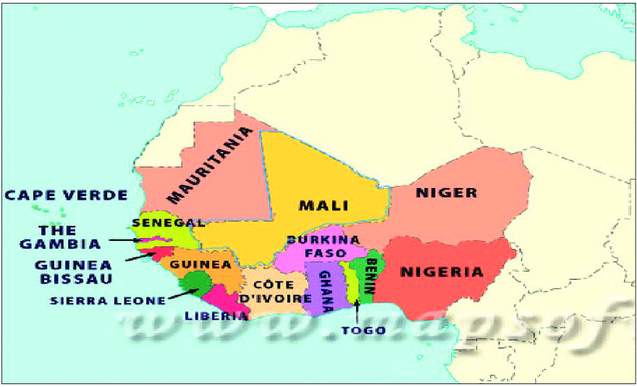
You are getting inducted into the foremost professional accounting body in West-Africa sub-region and indeed Africa

Slide 4
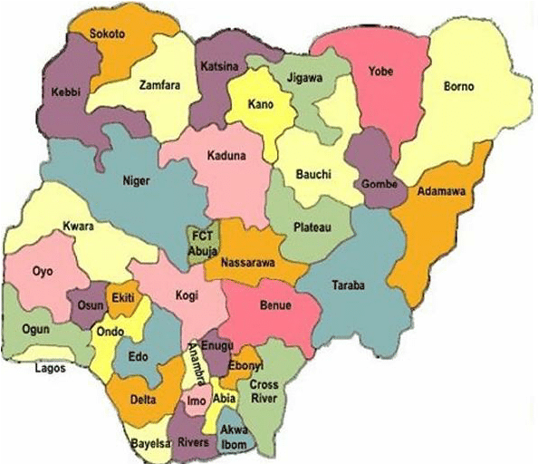
Nigeria
The giant of AFRICA
The most populous black nation of the world
Institute of Chartered Accountants of …………..

Slide 5
State of NIGERIA
INDICATORS | PERIOD | DIRECTION | PERCENT
Naira/1$ | 1999 – 2023 (Oct) | Increase | 1,344%
Inflation | 1999 – 2023 (Oct) | Increase | 303.6%
Population (Million) | 1999 – 2023 (Oct) | Increase | 87%
Migrant | 1999 – 2023 (Oct) | Increase | 75%
GDP ($ Billion) | 1999 – 2023 (Oct) | Increase | 704%
GDP (Per Capita in $) | 1999 – 2023 (Oct) | Increase | 71%
Minimum Wage (Naira) | 1999 – 2023 (Oct) | Increase | 300%
Minimum Wage ($) | 1999 – 2023 (Oct) | Reduction | 67%
Unemployment Rate | 2015 –2023 (May) | Increase | 149%
Source: Authors Computation (2023) from CBN, NBS, Worldometer Database, Adebisi (2023)

Slide 6
State of NIGERIA (Global Indices)
INDICATORS |  | 2023 (MAY)
Global Innovative Index |  | 114th of 132
Global Talent Competitive Skills |  | 109th of 133
Global Index of Economic Freedom |  | 124th of 176
Corruption Perception Index (CPI) |  | 150th of 180
Global Digital Competitiveness Ranking |  | Not Ranked (only SA)
Quality of Life Index |  | 196th of 197
Prosperity Index |  | 143rd of 166
Ease of Doing Business Index |  | 131st of 190
Global Competitive Index |  | 116th of 141
Sources: Author’s Computation (2023) from NBS, NUMBEO, ILO Database, Adebisi (2023)

Slide 7
WAYOUT
The only pathway to revolutionizing the Nigerian economy from its current deteriorated state, in the words of Adebisi (2023);
The Sole Ladder = Innovation
The Sole Option = Entrepreneurship
The Sole Platform = Nigerian Youth

Slide 8
TESTED AND TRUSTED
South Korea
Singapore

Slide 9
The case of Korea
Korean Government Policies for Industrialization
The government strongly supported exporting firms with various incentive measures, including favorable treatment in the allocation of credit and in the taxation system
Most of the export credit extended by domestic money banks (DMBs) were supported by the central bank
The interest rate on export loans was also heavily subsidized
The government also provided substantial tax incentives to exporting firms by reducing business and corporate taxes on export income by 50 percent and exempting tariffs on materials or intermediate goods imported as export content
exporters were exempted from tax investigations, which motivated business firms to restlessly participate in exporting.
National Bureau of Economic Research (1995).

Slide 10
The case of Korea
there was also a long list of governmental measures for export activity promotion at the microlevel
Since export marketing has substantial fixed costs in the beginning stages, the government established the Korea Trade Promotion Corporation (KOTRA) mainly to explore foreign markets
To assist Korean exporters in effectively filling foreign orders, the government also subsidized projects to improve the wrapping and design of products, the expansion of inspection facilities for export goods, the opening of foreign-language training centers, and traveling expenses for delegations to overseas expositions and trade shows
National Bureau of Economic Research (1995).

Slide 11
The case of Korea
The government also initiated close consultation with the export industries and monitored the performance of supported firms through “monthly export promotion expansion meetings,” chaired by the President
Ministers with trade related duties, representatives from business, banking institutions, and shipping companies, and labor-union leaders participated in these meetings to review export performance broken down according to product and destination, and to discuss international market trends and emerging problems.
Government’s support to exporting firms was based on export performance. (Competition --> Innovation)
National Bureau of Economic Research (1995).

Slide 12
FACTS
Averagely, startups do not make it beyond the first 5 years of existence
The most prominent issues faced by businesses are related to finance (access to finance, mismanagement of finance)
A wide gap to be filled by ICAN members
Nigeria is hungry for businesses with a well managed finance
Africa is hungry for successful (innovative) businesses with good financial undertone
The world is eagerly waiting for ICAN members to contribute their expertise to sustain businesses (startups) beyond the first 5 years of their existence

Slide 13
YOUNG ACCOUNTANTS
Nigeria has all it takes to be like the countries just discussed.
If all ICAN members can think entrepreneurially,
Opportunities abound to be tapped into.
Consider AfCFTA

