Slide 1


ICAN I.T FACULTY WEBINAR ON:
ARTIFICIAL INTELLIGENCE:
A GAME CHANGER FOR ACCOUNTANTS
Practical demonstration of AI capabilities in finance, accounting & analytics.
By: Moruf Kazeem MBA FCA moruffkazeem@yahoo.com
07062608911

Slide 2
Outline:
Artificial Intelligence & Chatbots
Chatbots capabilities (ChatGPT)
Guide to efficient prompt
Chatbots tools & websites
Limitations of chatbots (ChatGPT)
Practical demonstrations of ChatGPT:
    Creative/Corporate Content
    Financial Analysis
    Excel formula
    VBA Codes etc.

Slide 3
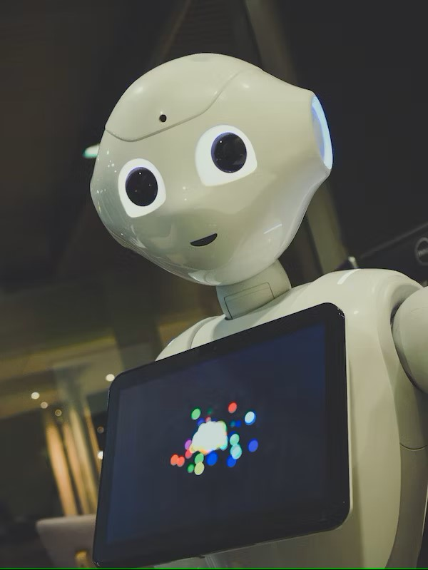
Artificial Intelligence
Artificial intelligence (AI) is a branch of computer science concerned with building smart machines, systems, and programs capable of performing tasks that are typically associated with human intelligence.
Recent AI revolutions include:
Self-driving vehicles
Drones
Robot-surgeon
Fin-tech
Fenceless farms
Chatbots (ChatGPT, Google Bard, Bing, etc.)

Slide 4
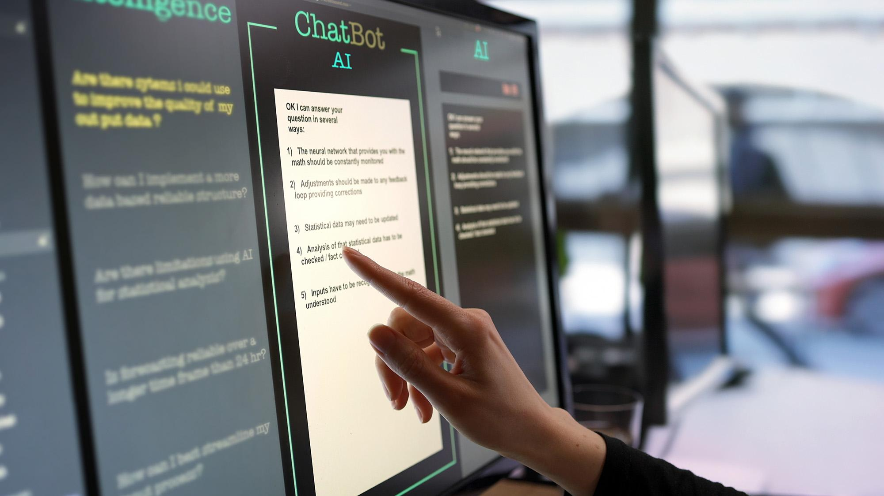

Chatbots
Chatbots are artificial intelligence tools that use natural language processing to create humanlike conversational dialogue. The language model can respond to questions, write content, social media posts, essays, code, and emails. E.g., ChatGPT, Google Bard, Bing etc.
Therefore, the essence of this webinar is to discuss and demonstrate how Accountants can solve corporate problems with AI tools like ChatGPT, Bard, Bing, etc.

Slide 5
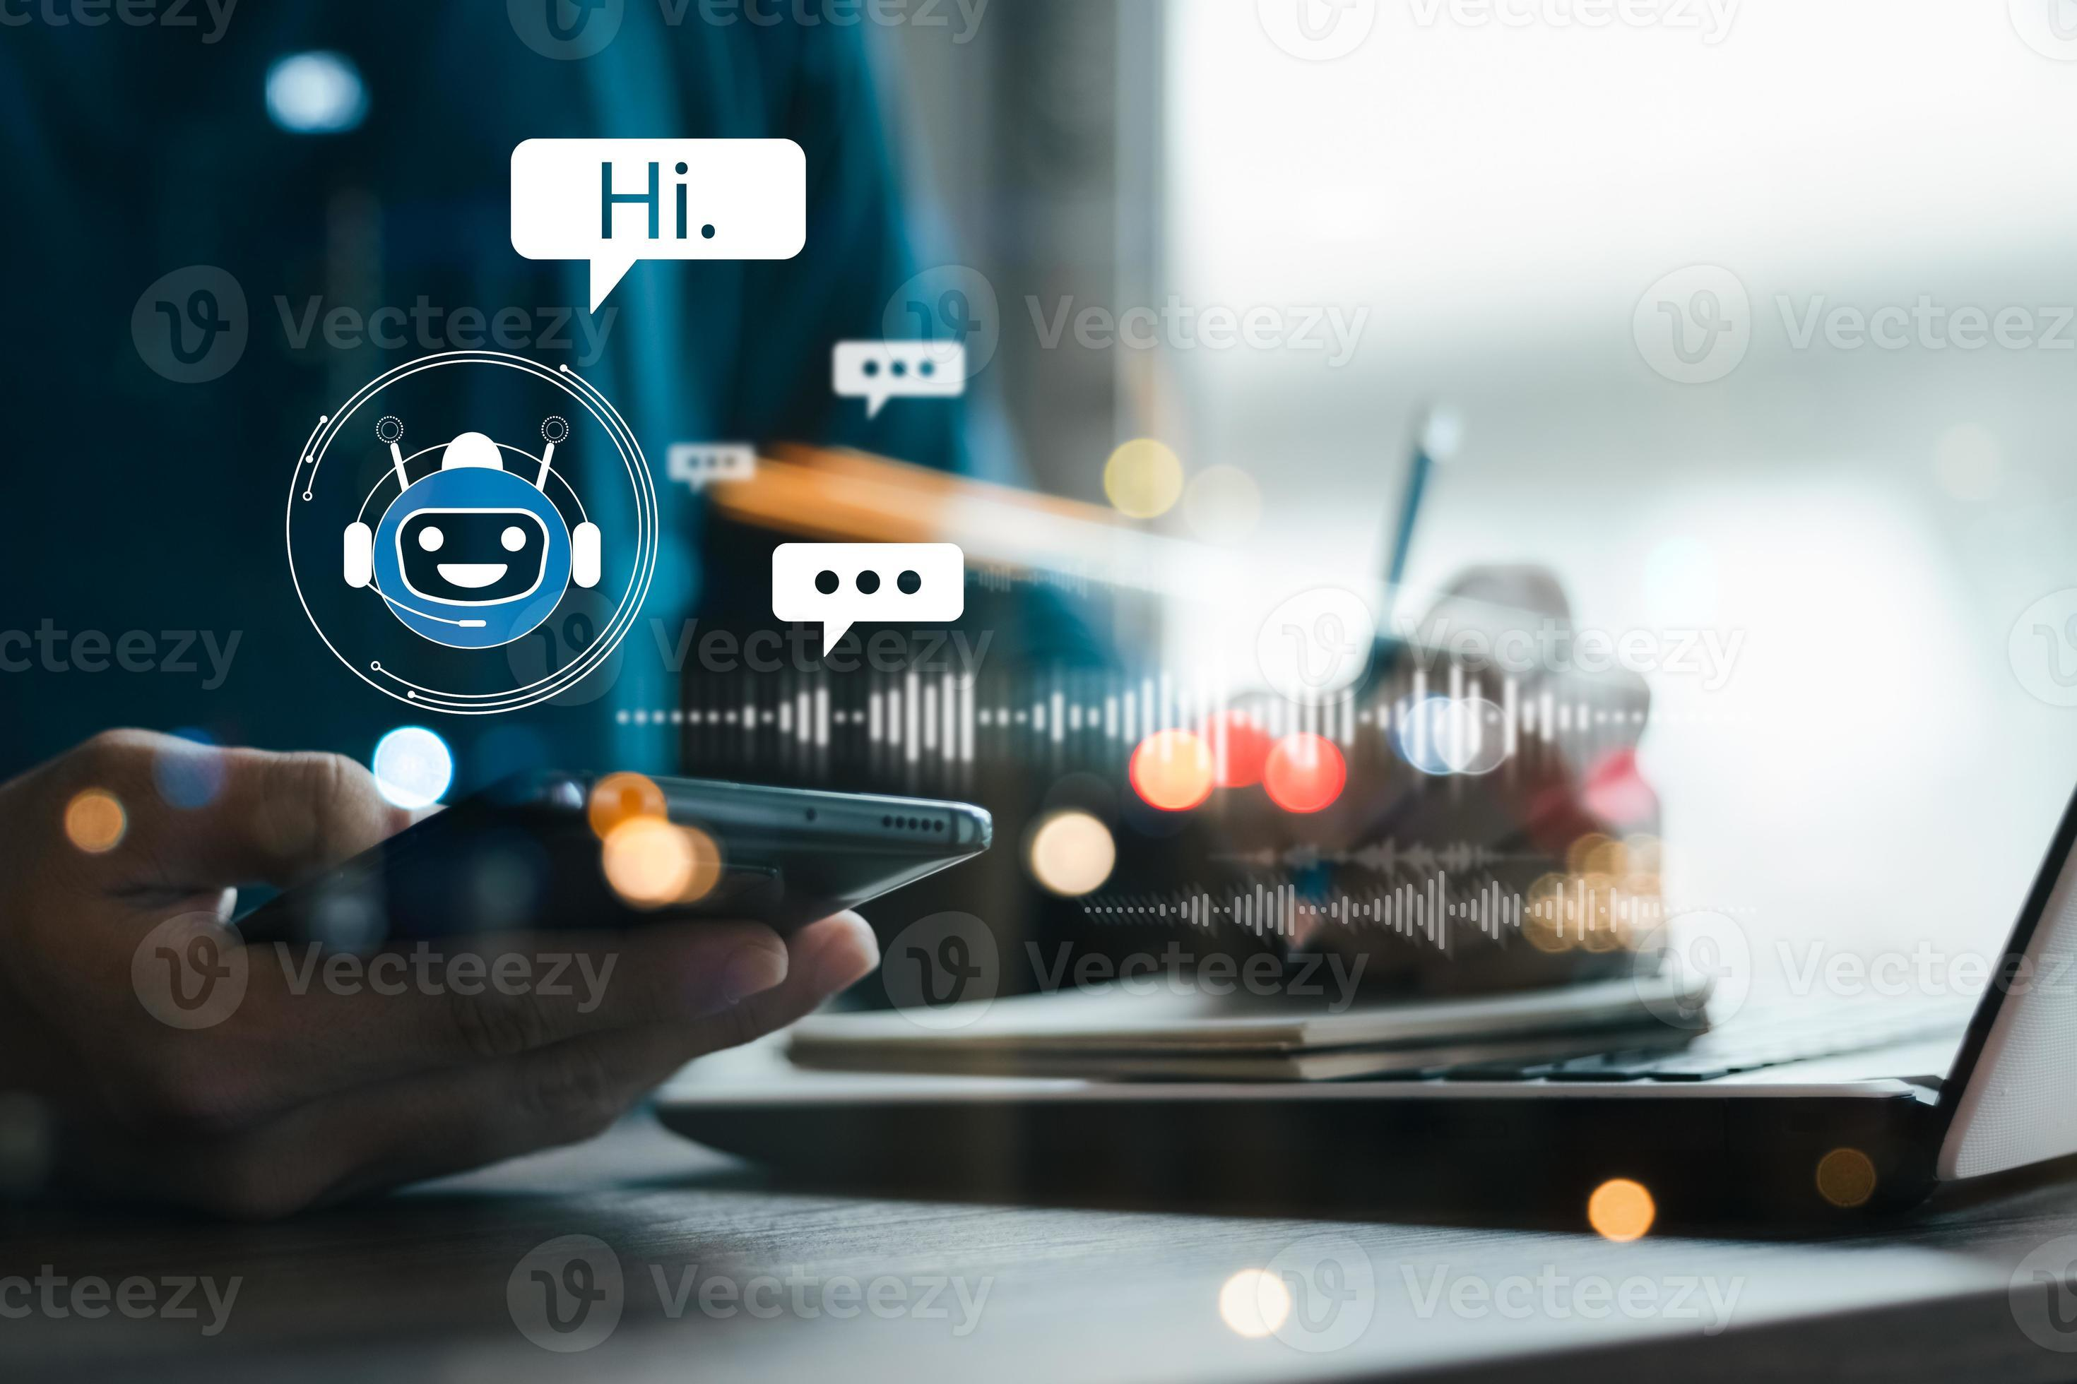
ChatGPT Capabilities
Capability | Application
Alternative to Google Search | ChatGPT offers a Google search alternative, delivering instant responses to user’s queries.
Roleplay | Ideal for roleplaying games, ChatGPT serves as a versatile virtual character.
Creative Writing | Generate high-quality content for marketing, advertising, emails, presentations, and more.
Write Code & Debug | ChatGPT assists in writing code and debugging software.

Slide 6

Capability | Application
Multilingual Support | ChatGPT comprehends and responds to various languages, enhancing its utility for multilingual applications.
Answer Questions | ChatGPT provides accurate responses to questions spanning finance, science, history, engineering, and literature.
Education Purpose | ChatGPT can be utilized in education to generate quizzes, tests, and other educational materials.
Brainstorm Ideas | ChatGPT aids users in brainstorming creative project ideas.

Slide 7
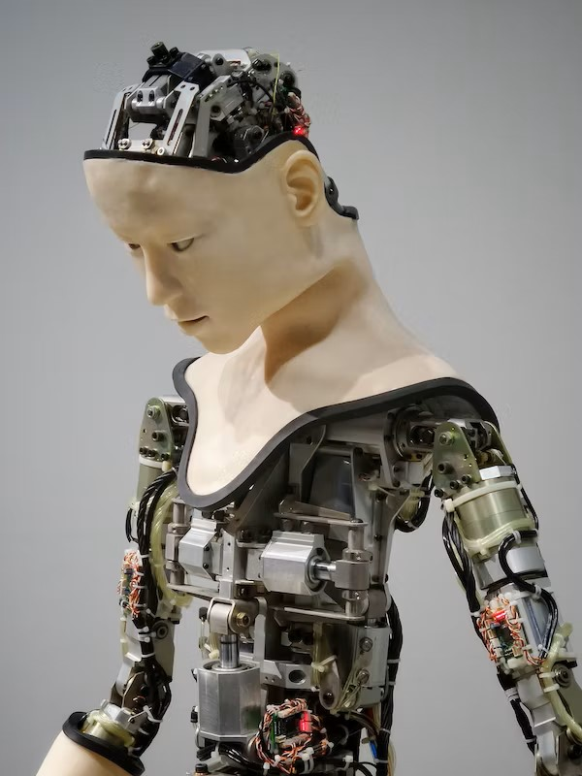
Guide to efficient prompt
PROMPT GUIDE | EXPLANATION
Start with a Clear Objective: | Begin your prompt with a specific goal or question in mind.
Be Explicit | Clearly state your request or question Use complete sentences and avoid ambiguous language
Provide Context | Offer relevant background information to help ChatGPT understand the context of your request
Specify Format or Length | If you want a list, summary, MS. Excel format, a short or long response…..mention it clearly.
Use Follow-up Questions | Ask follow-up questions for clarification.

Slide 8


PROMPT GUIDE | EXPLANATION
Avoid Biased or Harmful Content | Refrain from asking or promoting harmful, biased, or unethical content.
Experiment and Iterate | Feel free to experiment with different phrasings or prompts to refine the responses.
Acknowledge Limitations | Remember that ChatGPT is a multi-language model with limitations.
Provide Feedback | If you encounter errors or unsatisfactory responses, provide feedback to help improve the model's performance

Slide 9

AI Tools/Website
A.I. Tool | What it does | Website
ChatGPT | Offers content and text generation, and assists in writing, coding, brainstorming etc. | www.openai.com
Google Bard | Offers content and text generation, and assists in writing, coding, stories, brainstorming etc. | www.google.com/bard
DataMind | Predicts trends and insights from large datasets | www.datamind.ai
FormulaForge | Generates complex Excel formulas based on data | www.formulaforge.com
SlideGenius | Creates professional PowerPoint presentations | www.slidegenius.ai
CodeWiz | Generates VBA code for automating Excel tasks | www.codewiz.ai

Slide 10


A.I. Tool | What it does | Website
DataSift | Cleans and preprocesses data for analysis | www.datasift.io
ExcelBrain | Offers real-time Excel assistance and suggestions | www.excelbrain.com
PowerSlide | Enhances PowerPoint slides with AI-driven visuals | www.powerslide.ai
VBAWizard | Provides VBA code templates for Excel automation | www.vbawizard.com
DataAnalyzer | Analyzes datasets, identifies patterns, and trends | www.dataanalyzer.ai
ExcelifyAI | Converts natural language queries into Excel actions | www.excelifyai.com

Slide 11
A.I. Tool | What it does | Website
Copymatic (Text) | An AI-powered writing assistant that can help you write better content. | http://www.copymatic.ai/
StockImg AI (Design) | An AI-powered platform that helps you find and license stock images. | http://www.stockimg.ai/
HelloScribe (Writing) | An AI-powered tool that can help you transcribe audio and video recordings. | http://www.helloscribe.ai/
Palette.fm (Photoshop) | An AI-powered platform that helps you create music. | http://www.palette.fm/
Ortto (Email Writing) | An AI-powered tool that can help you translate languages. | http://www.ortto.com/artificial-intelligence-marketing
Fotor's AI (interior desIgn) | Text to image generator will output the best 3D decoration images based on the home | http://www.fotor.com/features/ai-interior-design/

Slide 12
A.I. Tool | What it does | Website
Pollinations (Image generation) | A platform that helps you build and manage AI projects with a team. | http://www.pollinations.ai/
Xpression Camera (avAtar) | An AI-powered camera that can help you create expressive photos and videos. | http://www.xpressioncamera.com/
Harvey (customer support) | An AI-powered tool that can help you write code. | http://www.hiverhq.com/harvey-ai-customer-support
Quizgecko (education) | An AI-powered platform that helps you create and manage quizzes. | http://www.quizgecko.com/
AutoRegex (coding) | An AI-powered tool that can help you create and manage regular expressions. | http://www.autoregex.xyz/
Altered (audioenhancer) | An AI-powered platform that helps you create and manage augmented reality experiences | http://www.altered.ai/
Socratic by Google (Research) | An AI-powered tool that can help you learn new things. | http://www.socratic.org/

Slide 13

Limitations of ChatGPT
Lack of Human Judgment | AI tools lack the ability to exercise human judgment and critical thinking which can lead to errors or misinterpretation of complex financial situations.
Data Dependence | AI tools heavily rely on accurate and relevant data. If the input data is incomplete or outdated, the AI's output can be flawed.
Lack of Creativity | AI tools are not creative problem solvers in complex business situations.
Initial Setup and Training | Implementing AI tools in accounting requires significant initial setup and training which can be costly for SME businesses. (e.g., GPT-4)

Slide 14

Maintenance and Updates | Failure to keep the AI tool up to date can lead to deteriorating performance and increased risks.
Security Risks | AI tools can be vulnerable to cyberattacks, security breaches, and data breaches.
Resistance to Change | Employees may resist the adoption of AI tools, hindering the successful integration of AI into accounting processes.
It Kills Initiatives | Excessive use of AI can lead to laziness………inability to think outside the box. Plagiarism etc.

Slide 15
Conclusion
AI won’t replace people, but those embracing AI will replace those who don’t. The global skill gap widens due to AI and automation, with 44% of workers’ skills predicted to be disrupted between 2023 and 2028. Generative AI is expected to significantly change job roles and skills, but only 28% of CEOs have assessed its impact. IMB STUDIES

Slide 16
Q&A Thank You!

